Slide 1

Workforce Skills Drive
Smart Manufacturing Success
Conrad Leiva
VP Ecosystem & Workforce Development, CESMII
Notes:
I’m Conrad Leiva, VP of Ecosystem and Workforce Development at CESMII, the Smart Manufacturing Institute.
I am an Industrial Engineer with over 30 years experience in manufacturing, over 20 in manufacturing systems and over 10 in Smart Manufacturing.
And today I’m discussing a very important topic… the Need for Workforce Skills in Smart Manufacturing !!
#

Slide 2






Growth in the Manufacturing Sector
will drive US competitiveness
4.6 million
manufacturing jobs
will be needed over
the next decade
Up to 1 million manufacturing jobs could be created by reshored production
and rising exports
$1.00 spent in manufacturing
adds $2.74 to the economy
Communities
of all sizes in America are manufacturing dependent
Source: Deloitte and The Manufacturing Institute​
Source: Boston Consulting Group
Source: National Association of Manufacturers
Source: USDA Economic Research Service
Notes:
We have a great opportunity ahead with manufacturing in the US. The offshoring trend has been replaced with a reshoring trend.
Many jobs continue to be created. Jobs that have a big impact on the economy!
#
4.6 million manufacturing jobs: https://www.nam.org/facts-about-manufacturing/ - Source: Deloitte and The Manufacturing Institute​
1.5 M new jobs due to expected growth in manufacturing / 2.5 M open jobs from retirements (assuming retirement age of 66)​
Information came from Deloitte analysis of Bureau of labor statistics data and Oxford global economic model​
Report created from Dec 2020-Feb 2021​
600K–1 M direct manufacturing jobs: https://www.bcg.com/publications/2015/manufacturing-reshoring (Boston Consulting Group)​
There isn't a specific source cited but they mention a 2013 survey and BCG's global cost-competitive index on the infographic ​
$1 spent adds $2.74: https://www.nam.org/facts-about-manufacturing/ - Source: NAM calculations using 2021 IMPLAN data​
Manufacturing-dependent counties: https://www.nist.gov/blogs/manufacturing-innovation-blog/geography-manufacturing-case-mep-and-rural-manufacturers​
USDA Economic Research Service "Rural America At a Glance: 2016 Edition" ​

Slide 3
U.S. Manufacturing is making a comeback
+1.3M jobs
from 2010 to 2019
Data Source: Lightcast, July 2023
Notes:
This job posting data reflects the growth trend for manufacturing in the US…and is expected to keep growing…
However, if we don’t have enough people to fill these jobs… we could see these jobs go somewhere else.
#
This is a visual to how the manufacturing job market has been growing and is expected to keep growing…

Slide 4









mission. strategy. role.
CESMII represents the
voice of manufacturing;
engaging the smart
manufacturing ecosystem
through a membership model
Driving the next wave of manufacturing productivity, energy productivity, sustainability and competitiveness through smart manufacturing innovation.
Manufacturer
System Integrator
SW App Vendor
Academia, Labs
Machine Builder
2017
$140M+
Improve Resource & Energy Productivity through Sensing, Control, Modeling, Analytics & Platform Technologies
Founded by
the D.O.E.
Private/public partnership
How.
Fund the Innovation and Education necessary to dramatically reduce the cost & complexity of using real time data from operations to drive revenue & cost improvements and generate cash.
www.cesmii.org
4
Notes:
First, I want to tell you about CESMII. We are one of 17 Manufacturing USA institutes funded by the US government to help manufacturers by accelerating the adoption of advanced manufacturing technologies. Each institute is dedicated to different technologies and CESMII is the one dedicated to Smart Manufacturing technology.
CESMII works on this mission with its members that include in addition to the manufacturers… the ecosystem that support them including.. machine builders, software vendors, system integrators and academia.
#
CESMII is a public-private consortia working on its mission with leaders from industry including manufacturers
and the ecosystem that supports them including machine builders, software vendors, system integrators and academia
#
Founded & funded by the US .gov in 2017
Private/public partnership - $140M+ over 5 years
We represent the ‘Voice of Manufacturing’
NOT a Vendor, NO product to sell
We fund REAL Manufacturing Innovation & Research that enables the Democratization of Smart Manufacturing
Technology (Digital Transformation)
Education & Workforce Development (Cultural Transformation)
Our members include the entire ecosystem supporting manufacturers including…

Slide 5

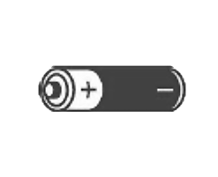

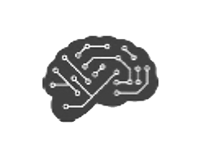

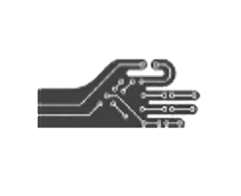
Smart Manufacturing is about Capabilities!
Internet
of Things
Process Modeling
Connecting
Things
Sensing,
Collecting Data
Providing
Insights
Smart
Manufacturing
Cloud
Computing
Artificial
Intelligence
Connecting the Ecosystem
Automating Flow
and Control
Augmenting
the Workforce
Mobile
Computing
Advanced
Robotics
www.cesmii.org
Notes:
To give you a better idea of what is Smart Manufacturing… Smart Manufacturing are the technologies and methods that give you these capabilities!
From Collecting Data to…
#
It is very important that we understand that Smart Manufacturing is not just about technology…
It is about what you can do with these technologies! The capabilities you can enable in your plant, operations, workforce, and supply chain.
Also note here that it goes beyond Providing Insights.. It also includes taking action to automate flow and control, augment the workforce and connect the whole ecosystem. We will elaborate more on these capabilities.
#
JW: AI? AI Needs DATA! Do you believe your data?
Ex. We had this cookie line using estimated data to determine vs using actual data
We needed to add context data to the raw data
#
Smart Manufacturing is about what you can do with these technologies !
The capabilities you can enable in your plant, operations, workforce, and supply chain.
This has always been the case since the movement started around 2006.
And that means that we need to teach Smart Manufacturing to many different occupations.
From leaders, innovation champions, to the IT and OT professionals that are learning to work together
.. To the workers that need to leverage the technology and information in their everyday jobs.!
#
Source: McKinsey Global Institute, May 2014
#
Looking good. I would suggest in the short term not to join Big Data with AI
If they insist on keeping it Nine, then I would replace Big Data with AI. It is more important than “big data” techniques.
If they can avoid numbering technologies even better. So many they will end up changing from 9 to 10 to 11 pretty quickly : )
For example, no mention of Digital Twins. It could replace Simulation as a broader label.
You and me know that the “pillars” are not the technology. So I would suggest ground the strategy on other more general pillars like:
Sense (Sensors, Vision), Connect (Bridge, Edge, ), Contextualize (Edge, Info Models, Twins) , Store (On Prem Edge Cloud, Big Data, Data Lakes), Automate (Robots, Smart Machines, Workflow), Secure, Analyze (Big Data, AI, ML) , Control (SPC, QA, Workflow), Improve(Kaizen, Trouble Shoot) and then relate technologies to what you are trying to do.
Technologies and Concepts
Sensing, Collecting data
IIoT devices, sensors, machines, manual data
Auto-ID (RFID)
Connecting things
Networking, Wired and Wireless
Bridging OT and IT networks
Exchanging data
Data/Information Modeling, Metadata management,
Data exchange standards - – OPC UA, MTConnect, MQTT
EAI – Enterprise Application Integration/API management
Organizing and Storing data
Databases, Data warehouses, Data lakes
Blockchain
Automating Logic and Control
On premise, edge, cloud
PLCs
Workflow, BPMN
AI/ML
Augmenting the Workforce
Human-Machine/User Interface
Mobile, Wearables
Augmented Reality
AI Assistance
Advanced manufacturing techniques
Additive
Robotics

Slide 6
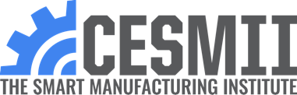

Realizing the 4th Industrial Revolution through
Smart Manufacturing
Today’s Reality
Tomorrow’s Outcomes
FIRST PRINCIPLES OF SMART MANUFACTURING™
❌ Data Silos, Stovepipe Architecture
❌ Proprietary, Vendor Lock In
❌ No Interoperability
❌ Difficult to Scale – Up or Down
❌ Delayed & Reactive Decision-Making
❌ Nonoptimized Resource & Energy Use
❌ Islands of Innovation, Pilot Purgatory
✅ Interoperable & Open
✅ Sustainable & Energy Efficient
✅ Secure
✅ Scalable
✅ Resilient & Orchestrated
✅ Flat & Real Time
✅ Proactive & Semi-Autonomous
1970
1980
1990
2000
2010
2020
2030
2040
2050
The 3rd Industrial Revolution
The 4th Industrial Revolution Vision
www.cesmii.org
Proprietary, Closed
No Interoperability
Data Silos
Stovepipe Architecture
Vendor Lock-in
No Application Portability
Difficult to Scale – Up or Down
Interoperable & Open
Sustainable & Energy Efficient
Secure
Scalable
Resilient & Orchestrated
Flat & Real Time
Proactive & Semi-Autonomous
Notes:
We believe that the vision for Industry 4.0 has not been realized yet (at least not at scale!). So our mission is to make these techniques available beyond the early adopters…
To make sure that the productivity benefits are realized by the average manufacturer in the US!
#
The mission to realize the vision of Industry 4 that has not been realized yet… at least not at scale.
We have worked together to define Smart Manufacturing, the principles and best practices that we must all get behind to elevate the whole industry!
#
Forty years of growing hardware, firmware and software maturity
Largely proprietary networking and information infrastructure
Growing recognition of the need for OT & IT convergence

Slide 7

















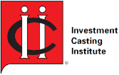








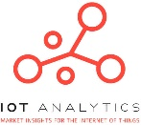














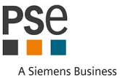

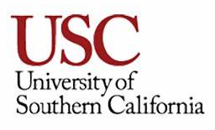

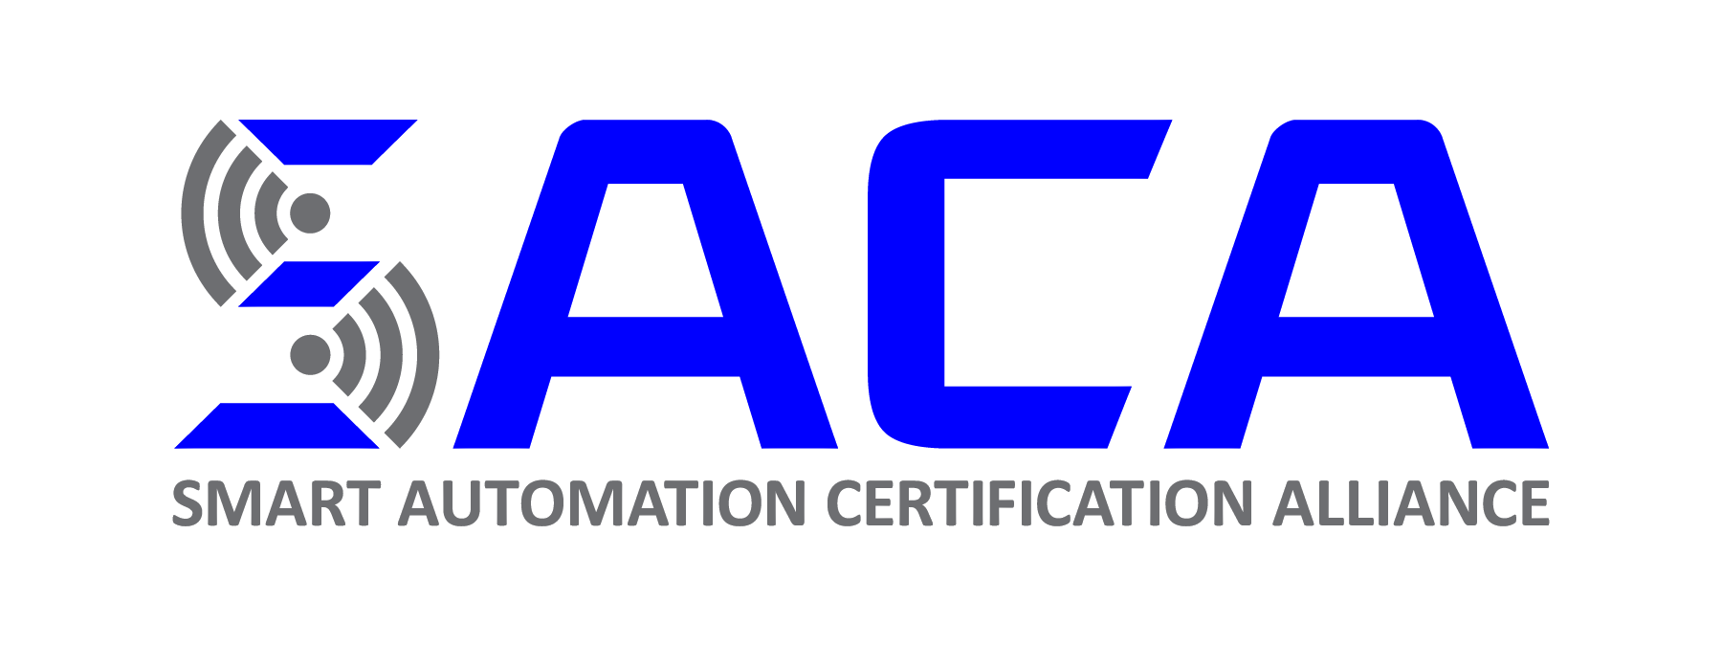









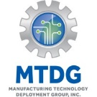
































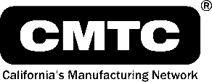


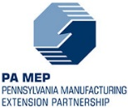



















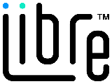








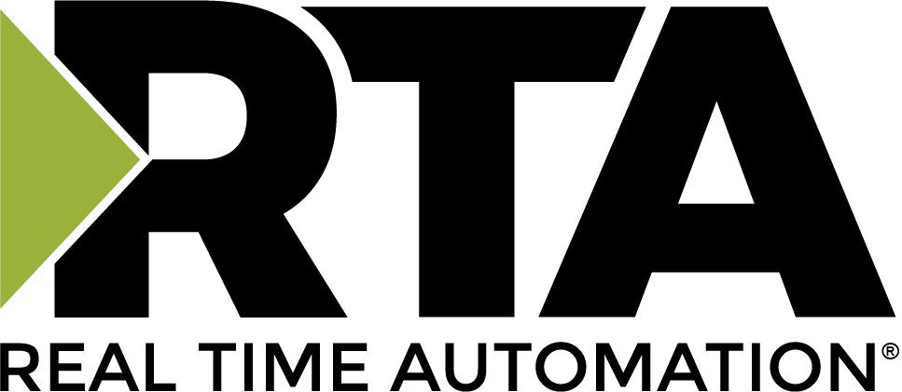


Ecosystem of >170 Collaborating Members
www.cesmii.org
Notes:
And we are very privileged to have a great growing list of industry leaders that are members… all committed to this mission! Over 180 right now!
#
These are some of the organizations working with us. The list keeps growing, we are currently over 170+ members.
#
And CESMII is not working alone in this effort, CESMII is a consortia with many manufacturers, technology vendors, system integrators, and academia.
All collaborating with the same mission to make these methods more accessible to more small and medium manufacturers.
#

Slide 8

Challenges to achieving Smart Manufacturing
Lack of skilled talent
Cost required to implement
Complexity of system integration
Lack of technical expertise
Time required to implement
Lack of clear investment benefits (return on investment)
Lack of time to invest in initiatives
Lack of willingness to abandon legacy/standard tools and technologies
Lack of connection between technology and business strategy
Lack of clear implementation path to follow
Lack of willingness to change how we work
Cybersecurity
Lack of executive leadership support
Uncertain about the benefits
Not a top priority for our company
Lack of data from which to make decision
Lack of big data models
Requires a new plan for data governance and data access rights
None of the above/NA
Other
Top Challenges
1
Need for skilled talent
2
Cost & complexity to
Implement and Integrate
3
Lack of connection between technology and business strategy/benefits
Source: CESMII and SME Smart Manufacturing Survey May 2022
http://www.cesmii.org/education
Notes:
Technology innovation is moving at a fast pace and it has become more affordable and practical to implement technology
like sensors, connectivity, big data and machine learning in the last 20 years.
When Manufacturers are asked about their Challenges to Achieving the Fourth Industrial Revolution,
The main challenge is not the technology… the main challenge is the lack of SKILLED TALENT !
#
Technology innovation is moving at a fast pace and it has become more affordable and practical to implement technology
like sensors, connectivity, big data and machine learning in the last 20 years.
You can see how fast the price and capacity is improving with these examples from IDC and McKinsey.
<advance
In fact, Technology in NOT the biggest challenge identified by manufacturers…
The top two challenges are…
Lack of Talent with the Skills Required
Lack of Interoperable Systems – Integration if too difficult and too costly
These two Challenges that are holding us back from taking advantage of all the technology available today.
#

Slide 9

Manufacturers Lack Skilled Workers for SM
Manufacturers around the world are under pressure to bring their factory workforce into the 21st century, yet 57% of manufacturing leaders say that their organization lacks skilled workers to support digitization plans, according to a survey by Gartner, Inc.
The 2020 Gartner Smart Manufacturing Strategy and Implementation Trends Survey was conducted online between October and December 2020. In total, 439 respondents were interviewed across North America, Western Europe, and APAC.
“Our survey revealed that manufacturers are currently going through a difficult phase in their digitization journey toward smart manufacturing,” said Simon Jacobson, vice president analyst, with the Gartner Supply Chain practice. “They accept that changing from a break-fix mentality and culture to a data-driven workforce is a must. However, intuition, efficiency and engagement cannot be sacrificed. New workers might be tech-savvy but lack access to best practices and know-how — and tenured workers might have the knowledge, but not the digital skills. A truly connected factory worker in a smart manufacturing environment needs both.”
Notes:
In fact Gartner also found that 57% of manufacturers said they lack they skills required!
#
Source: Gartner Survey Shows 57% of Manufacturing Leaders Feel Their Organization Lacks Skilled Workers to Support Smart Manufacturing Digitization Plans
Sarah Hippold, Gartner, 2021

Slide 10

Manufacturing Jobs Need New Skills
Smart Manufacturing covers techniques that leverage data throughout the manufacturing enterprise for improved process control, decision making and utilization of resources.
Manufacturing jobs are changing because of new cutting-edge technologies…
Industrial Controls Technician
-> Automation IT Technologist
Quality Control Inspector
-> Quality Assurance Analyst
Process Simulation Specialist
  -> Machine Learning Specialist
Ergonomics Designer
  -> Worker Experience Designer
CAD Design Engineer
-> Digital Twin Engineer
What new skills are or will be required?
Digital Literacy, Data Analysis
Combining Edge and Cloud solutions, IIoT, MES, ERP
Data Capture, Connectivity: MQTT, OPC-UA, APIs, GraphQL
Data Management, Big Data
Programming: Python, C++
Low-code App platforms
What levels of education are or will be required?
Requirements shifting from 4-year to 2-year for many jobs even HS+
Stackable Professional Micro-Credentials becoming more recognized by industry
Notes:
Thanks to advances in technology, many manufacturing jobs are changing. These are some examples of changing jobs and the types of skills that are desired in these evolving jobs.
In fact, the Operator, the machine mechanic, the data analyst, manufacturing engineer… are all occupations that need these new skills!
Manufacturers also used to require four years for many of these jobs, but that is also changing….
#
Manufacturing jobs are changing because of new cutting-edge technologies…
Industrial Controls Technician
-> Automation IT Technologist
Quality Control Inspector
-> Quality Assurance Analyst
Process Simulation Specialist
-> Machine Learning Specialist
Ergonomics Designer
-> Worker Experience Designer
CAD Design Engineer
-> Digital Twin Engineer

Slide 11


Various Occupations Require SM Skills
Controls/Automation Technician/Specialist
Avg Salary: $62,500
Days Posted: 33 days
Projected Growth 5%
Base Skills:
  PLCs, HMIs, Mechatronics
Advanced Skills:
(+$10-20K)
  IIoT, Data Capture, Python, SCADA, MES integration, Robotics
Quality Control/Assurance Inspector/ Analyst
Avg Salary: $58,500
Days Posted: 30 days
Projected Growth 10%
Base Skills:
  Measurement, Quality Metrics, Auditing
Advanced Skills:
(+$10-20K)
  Data Management, Statistical Data Analysis, Root-Cause, Six Sigma
Notes:
Let’s look at these examples of manufacturing jobs. Good paying jobs! with projected demand growth.
We have noticed that advances skills like SM skills are paying a premium salary. An extra $10-20K!
#
What type of jobs needs these skills?... In fact, many manufacutirng occupations need these skills. Here I am showing a couple of them…
But the Operator, the machine mechanic, the data analyst, manufacturing engineer… are all occupations that need these new skills!
#

Slide 12
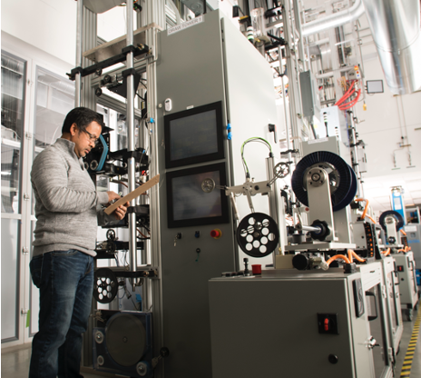
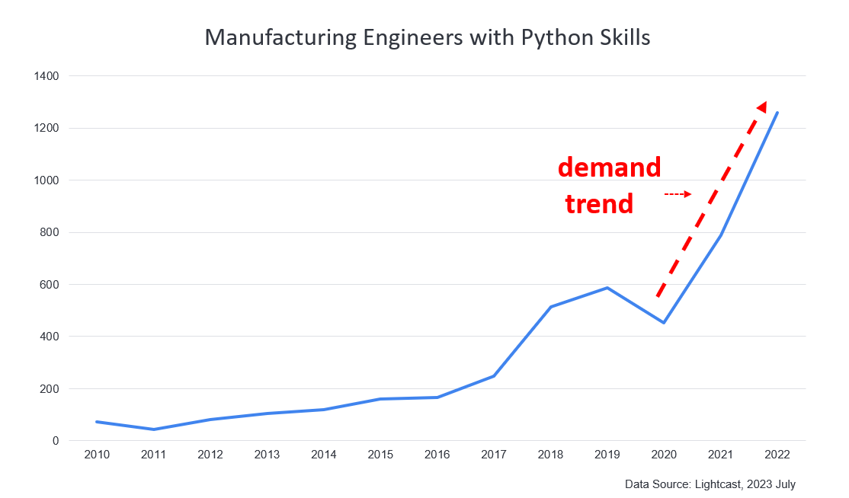
Various Occupations Require SM Skills
Manufacturing/Process
Engineer
Avg Salary: $92,500
Days Posted: 27 days
Projected Growth 12%
Base Skills:
  Mfg/Process Eng, Product/Process Dev, Automation, Lean, SPC, FMEA
Advanced Skills:
(+$10-20K)
  AI/Machine Learning, OT-IT integration, API, Python, R, C#
SM Skill Trends
Notes:
Dove deeper into the Manufacturing Engineer job postings… took Python as an example of a new skill requirement…and found that the demand trend is moving up fast for these new skills!
#

Slide 13


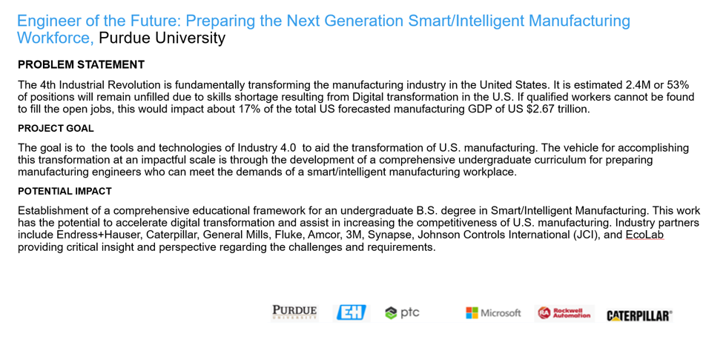
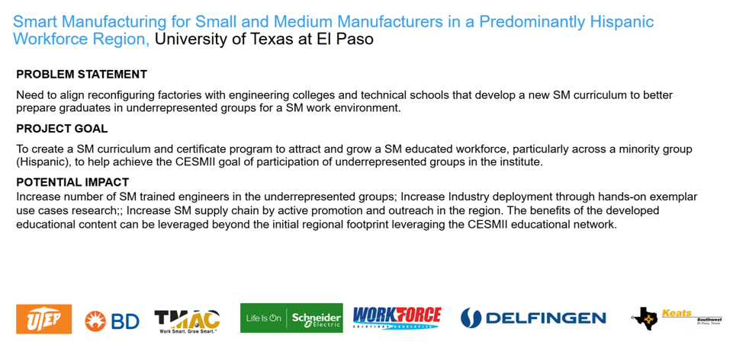



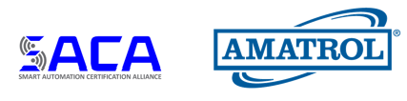
SM Education Projects
Workforce Development Model
For SM College and Career Pathway,
El Camino Community College
Factory 4.0 Educational Toolkit
With Tabletop Hardware and Education Modules, Penn -State
SM education elements that can be adopted by existing workforce education programs including Incumbent workforce training, Post Bachelor SM Professional Certification, Community College and Engineering.
Develop a bench scale extrusion kit and platform that can be integrated into education modules for data collection, analytics, digital twin, process control optimization, systems optimization.
2021-2022
Engineer of the Future: Preparing the Next Generation Smart Manufacturing Workforce, Purdue
Scalable Curricula for Smart Manufacturing Shop Floor & Machine Tool Data Analytics, Festo
Smart Manufacturing for Small and Medium Manufacturers in a Predominantly Hispanic Workforce, UTEP
IoT-Enabled Manufacturing Testbeds for Democratizing SM Knowledge, Technology and Innovation, Auburn
Establishing B.S. degree in Smart Manufacturing. Education curriculum will leverage several new SM labs for both discrete and process manufacturing.
Creating modular and scalable curricula to allows students of diverse backgrounds to learn SM technologies and data-driven analytics with realistic industrial system.
SM skills curriculum and certificate program to attract predominantly minority population to SM careers.
SM training modules that leverage Jupyter notebook to deliver hands-on exercises on data science and machine learning using data from industrial lab.
2022-2023
SM Skills Ladder for Undergraduates and Incumbent Workers, Finger Lakes Community College
Scalable SM Workforce Development Model with Digital Twin, Amatrol, TEES
Modular Smart Manufacturing Certifications, SACA
2023-2024
Develop basic, intermediate and advanced resources for educating students on SM at community colleges. Accelerate. Adoption of SM techniques in small and medium businesses through co-op experiences.
Scalable community workforce development model with flexible, low-cost teaching tools. Develop education, digital twin tools and teach community college professors.
Add SM certifications to existing certification program to provide convenient method for workers to accumulate SM skills.
Notes:
Projects are the main way we create resources and education programs in the ecosystem… California Community Colleges, Penn State, UTEP… are great examples of organizations building SM curriculum and resources…
#
RFP3 – Workforce focus – TEES project Train the Community College Professor,
SACA Credentials
SOW - ToolingU target Q1 2023,
Second phase NxGen – Train Consultants,
Second phase Amatrol – Train OT-IT Technologists,
#
You can see the logos of the great partners we have in these endeavors including Purdue, Fest, West Virginia, U Texas El Paso, and Auburn.
The three on the right are not RFP projects. They are partnering projects that are helping us create new REVENUE streams!
#
PROJECT - Scalable Curricula for Smart Manufacturing Shop Floor & Machine Tool Data Analytics
POSITIVES
Includes modules on productivity analysis, energy analysis, and connectivity
Partnership between academia and technical education pro, Festo Didactic, with a proven track record of edu for mfg!
PROJECT - Smart Manufacturing for Small and Medium Manufacturers in a Predominantly Hispanic Workforce Region
Includes a wide range of technologies from PLC, to robotics, to augmented reality and simulation
This project has some great partners in TMAC MEP and industry alliance/collaboration …
I am excited about this project because of its focus on Diversity in demographics
but also for its focus on SM for SMMs ! (Because the needs of SM technology to deploy at SMMs does not always match the approaches for larger co.)
#
PROJECT - IoT-Enabled Manufacturing Testbeds for Democratizing SM Knowledge, Technology and Innovation
POSITIVES
Good industry representation in the project (pulp & paper), as well as flow manufacturing
It has a tight focus on IIoT and AI subject with a nice mix of hands-on equipment and applied education.
With Strong tie to CESMII technologies and platform methods
#
Ragu will cover the Purdue project after we here form the California projects…
I don’t want to steal his thunder, but this project is very exciting because it is pursuing an new undergraduate program in SM.
#
PROJECT - Engineer of the Future: Preparing the Next Generation Smart/Intelligent Manufacturing Workforce
POSITIVES
Ambitious project with Comprehensive view of SM and nice building blocks. Build on top of Industry 3 with I4.
Institution has already started investing in Smart Mfg program. Good staff leading program.
Bolts on to existing SM minor at Purdue. Introducing Industry 4.0/Smart Manufacturing BS degree based on 9 core capabilities.
Leverage 4 training facilities at Purdue.
Good technology partners. Supported by MS, Rockwell, PTC.
Fits SMIC and/or Cyber Maker Learning Labs model.
Integrated value chain on campus is very attractive. Frameworks tied to business success is clear differentiator.

Slide 14
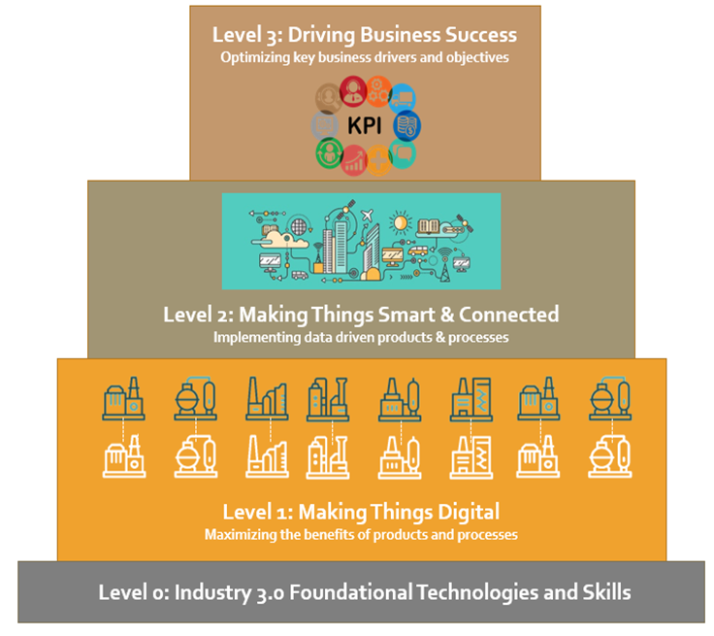
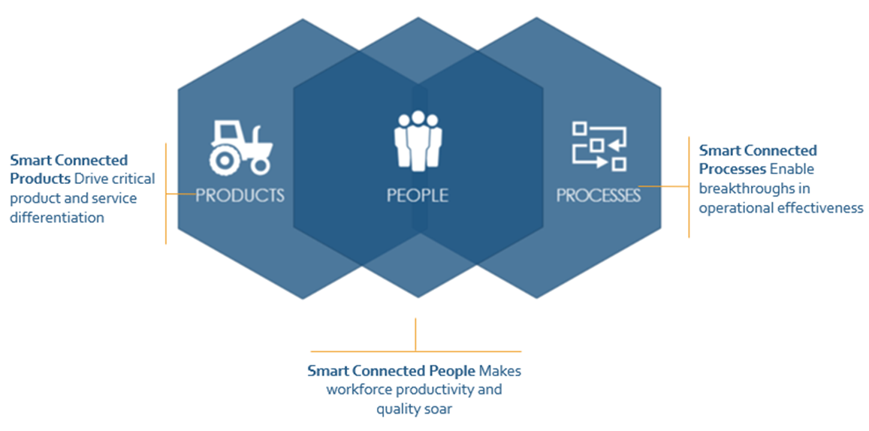
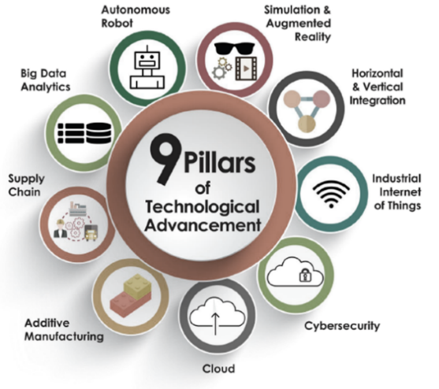
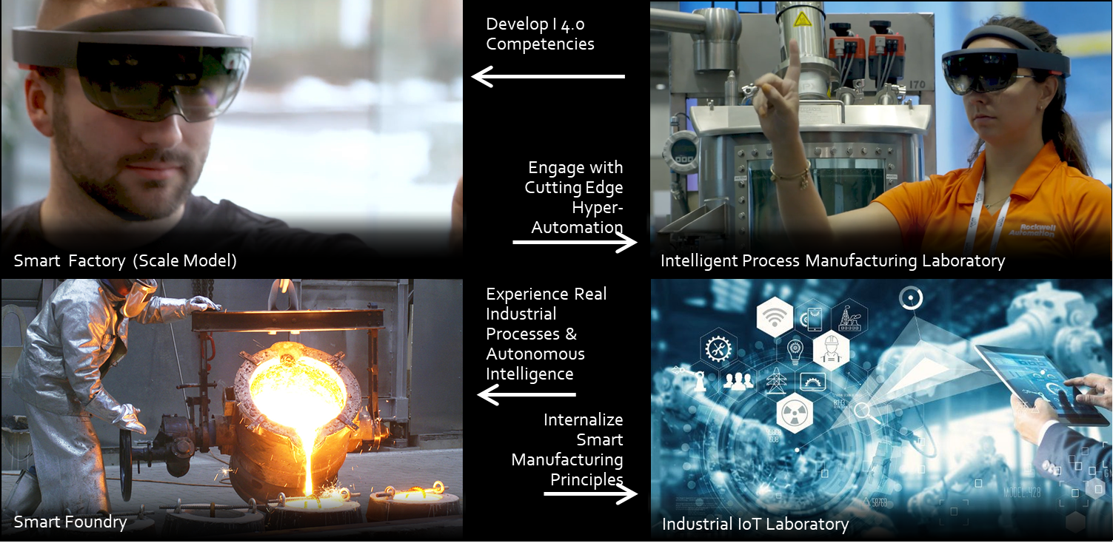
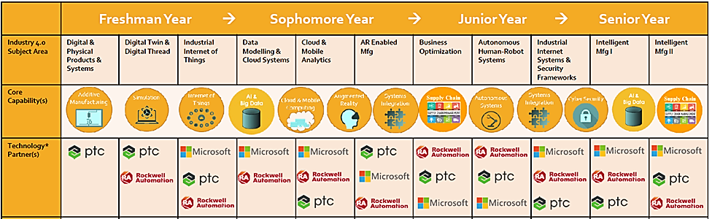
Smart Manufacturing Industrial Informatics
Learning Activities to Develop Critical SM Skills/Competencies
4-yr BS Curriculum
Notes:
Purdue created a new undergraduate degree on Smart Manufacturing and created a Smart Factory lab for hands-on skills.
This program serves as a great example for other universities. Dr, Ragu is here and can describe their project…
#
We systematically operationalized the tools and frameworks to:
Build a 4-yr curriculum
Laboratories and learning experiences to develop critical SM skills/competencies

Slide 15


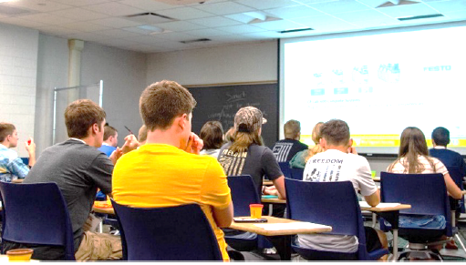
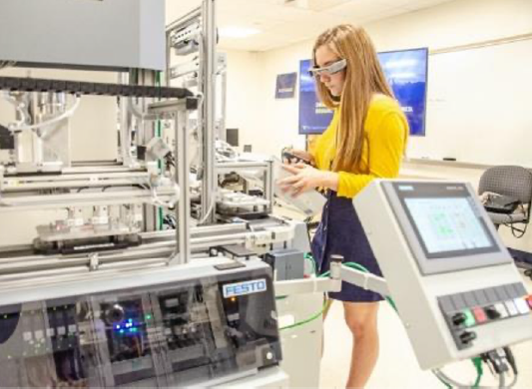
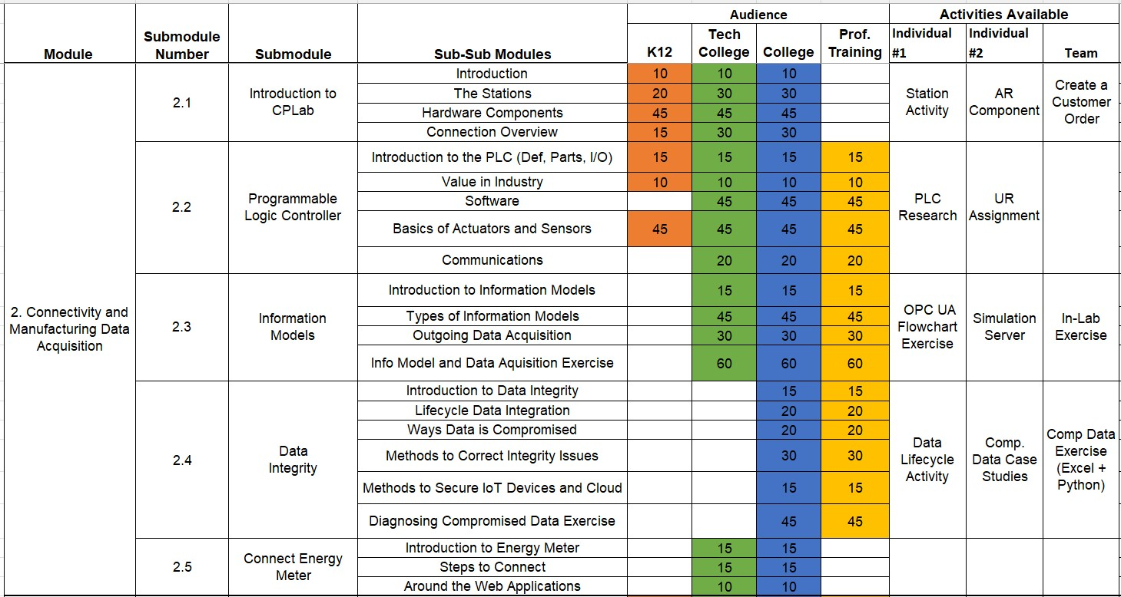
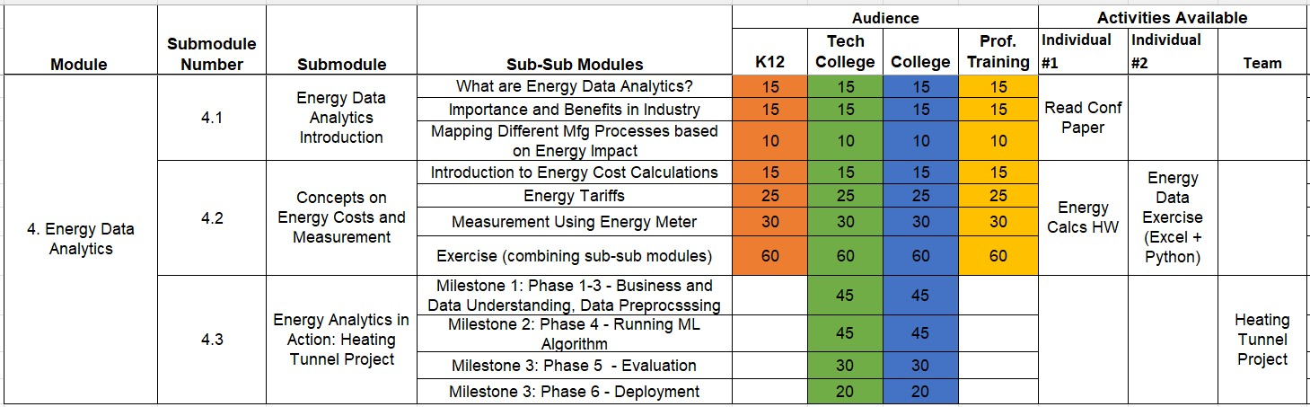
Smart Manufacturing Scalable Curricula
PROBLEM TO BE SOLVED:
Missing continuity as students’ progress through education system
Lower-level training programs utilize equipment focused on specific technologies
Missing broader context of working manufacturing cell or complex SM system
APPROACH:
Create modular & scalable curricula for students of diverse backgrounds to learn hands-on application & utilization of data-driven analytics in complex SM system
BENEFITS:
Festo now has SM curriculum with CPLab equipment that can be used at other education programs.
Modular curricula developed can be grouped differently for diverse SM education programs at high school, college and university levels.
Student exercises with industrial examples can lead to innovation that improves productivity for manufacturers.
SM MODULES:
SM Concepts and Basics
Data Capture and Connectivity
Manufacturing and Energy Analytics
EXCERPT
Notes:
The West Virginia University is another example, Festo worked with them to create multiple modules to teach SM with hands-on exercises on the Festo CPLab equipment.
On the right side, you see an excerpt of their guidance for how the modules can be used to teach K12, college and university levels.
#

Slide 16
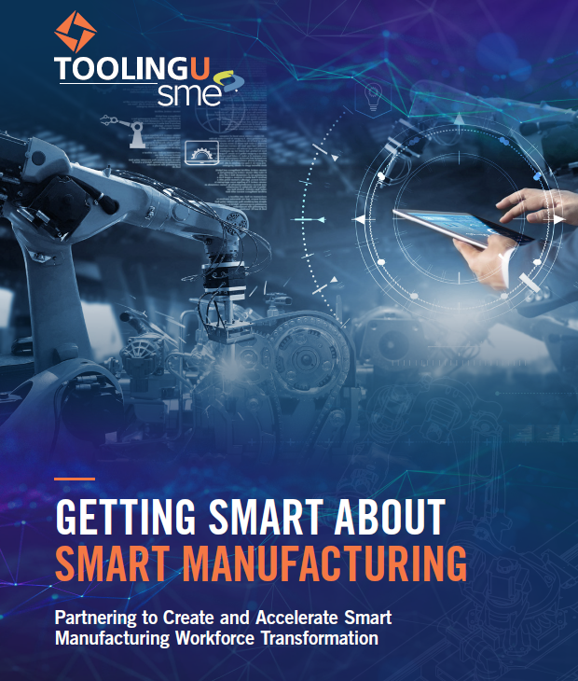


eLearning Courses – SM Fundamentals
Introduction to Smart Manufacturing
Introduction to Smart Manufacturing (new)
Smart Business Strategy – Adopting Smart (new)
Smart Business Strategy – Digital Enterprise
Smart Business Strategy – Data Management
Capturing & Organizing Data
IIoT Infrastructure and Smart Manufacturing (new)
Big Data and Smart Manufacturing (new)
Introduction to the Industrial Internet of Things
Data Collection Fundamentals
Data Collection: Inventory and Maintenance
Automatic Identification Technology
Connecting Data, Platforms & Systems in Smart Manufacturing
Integrating Across System Architecture Layers for SM (new)
Integrating Across Business Functions for SM (new)
Introduction to Digital Networks
Introduction to PLCs
Introduction to Digital Thread
Introduction to Digital Twin
Vision Systems
Providing Insights for Enhanced Decision Making
Digital Lean – Enhancing Lean with Digital Techniques (new)
SPC Overview
Troubleshooting
Continuous Process Improvement: Managing Flow
Continuous Process Improvement: Identifying and Eliminating Waste
Automating Flow & Control
Smart Manufacturing Process Modeling and Optimization (new)
Automated Systems and Control
Introduction to Machine Learning and Artificial Intelligence
Machine Learning and Artificial Intelligence Applications
Augmented Worker (new)
Applications for Robots
Introduction to Collaborative Robots
Smart/Digital Supply Chain (new)
Cybersecurity
Cybersecurity Tools and Methods (new)
Cybersecurity for Manufacturing Basics
Cybersecurity for Manufacturing: Malware Overview
Cybersecurity for Manufacturing: Hacking Overview
Cybersecurity for Manufacturing: Wireless Networks
Add stuff here
CESMII Members may purchase licensed access to the SM Fundamentals e-Learning program for an annual cost of $745 per student/employee. (35 for the price of 25!) and may apply their member benefits (i.e. CESMII dollars) towards this program.
CESMII | Tooling U-SME - CESMII
Notes:
In our project with ToolingU, we developed an eLearning package of 45min online courses on SM Fundamentals.
We have updated many of these courses and created 12 new courses!
#

Slide 17
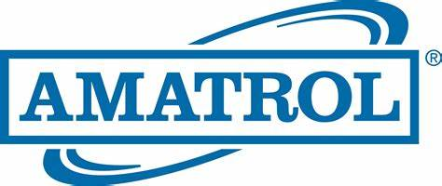
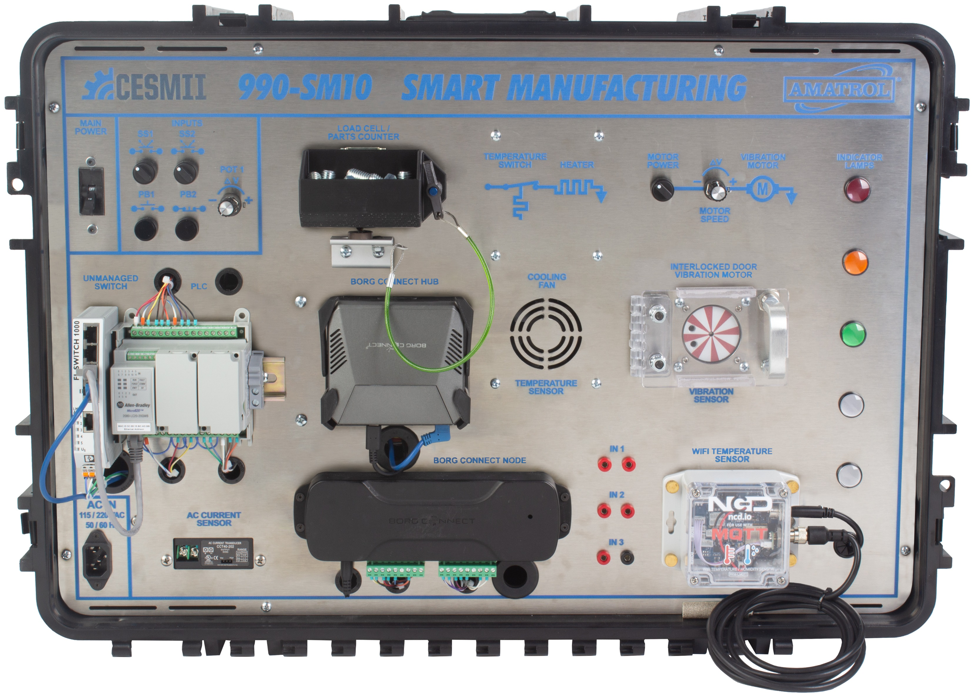
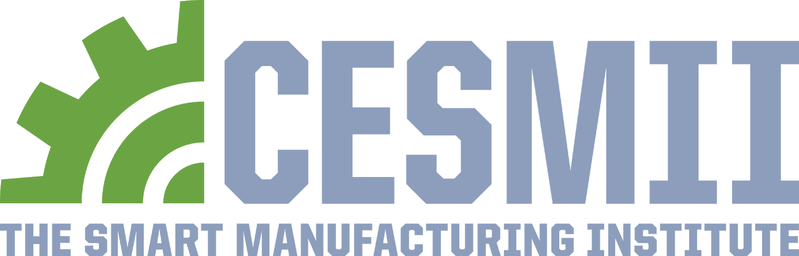
SM Learning System - 990-SM10
Manual Controls
Production Parts Counter
Temperature Control
Motor Control
Main Power Switch
Indicator Lamps
  Developed jointly with CESMII
MQTT Temperature/ Humidity Sensor
PLC
Borg
Connect
Hub
APPLICATIONS:
Heating/Cooling (Fan, Heating Element, Thermistor)
Condition Monitoring (Vibration Sensor)
Machine Operation (Conveyor/Motor Control)
Temperature Monitoring (Remote (option), Local)
Power Monitoring (Internal Current Sensor)
Wireless Parts Counting (force)
Ethernet Network Switch
AC IN Power
Borg Connect Node
Internal Current Sensor
Inputs
Notes:
With Amatrol, we developed this SM Learning System to have an affordable and practical way to teach SM skills at community colleges and manufacturers.
<next>
#

Slide 18

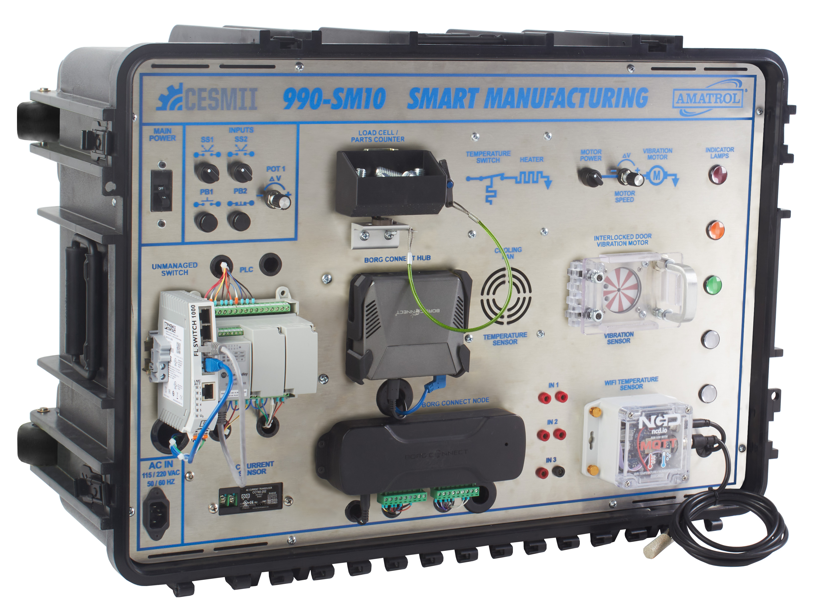
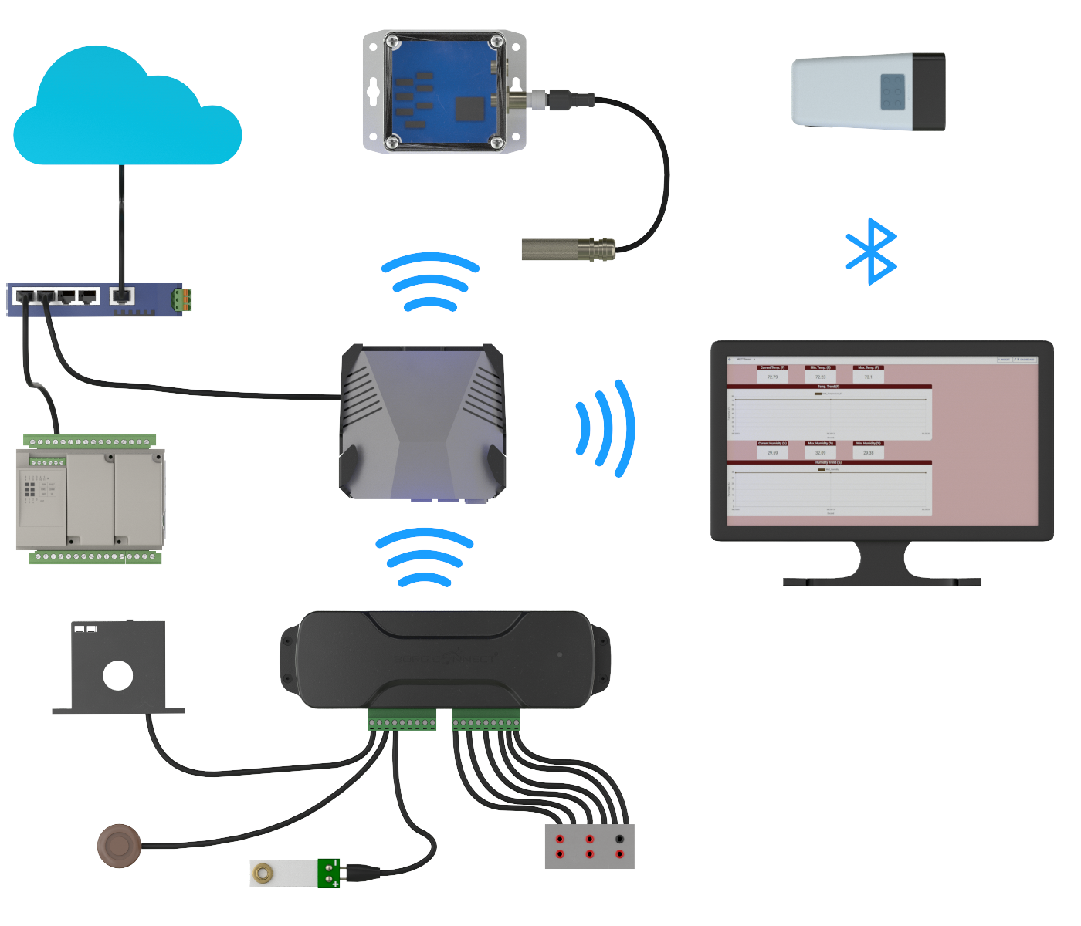
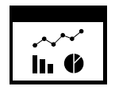
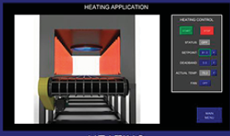
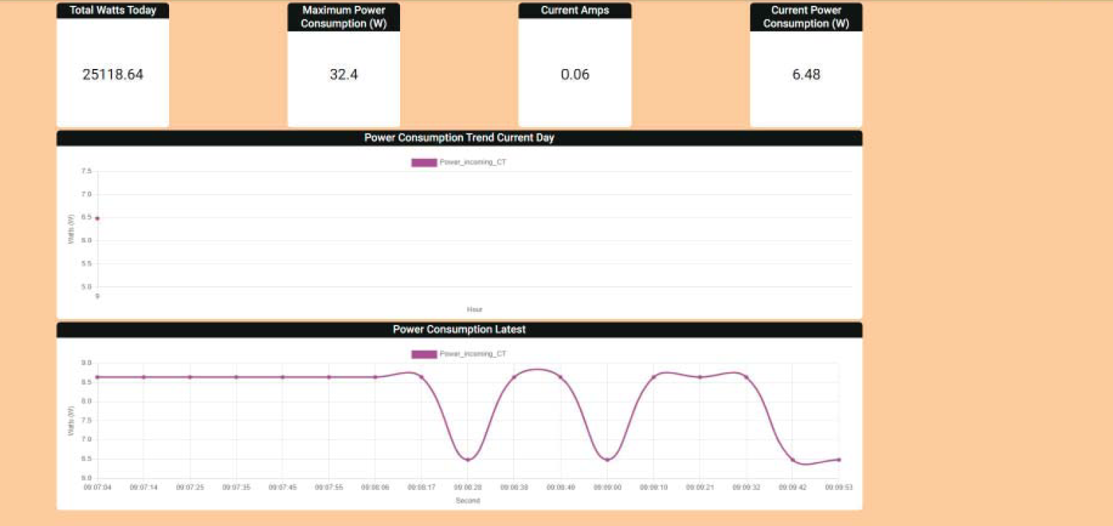

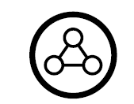
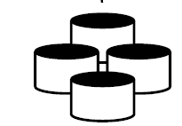


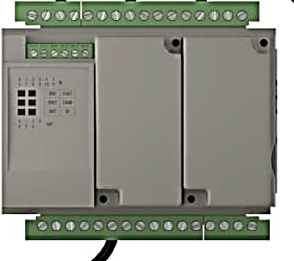

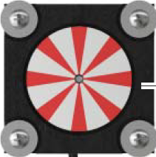
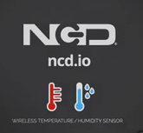
CESMII-Amatrol SM Learning System
Data Skills with Wired & Wireless Sensors, Edge & Cloud Platform
Dashboards, Analytics, Apps
CESMII
SMIP
Borg
Platform
PC / Laptop
with Dashboard
Network Switch
Borg Connect Hub
Exercises in the context of industrial use cases for:
Production
Quality
Maintenance
Indicator Lights
PLC
SM Learning
System
990-SM10CL
Bluetooth Scanner
Borg Connect Node
Cooling Fan
Heater Block
Motor
Wi-Fi Temperature
& Humidity Sensor
Vibration Sensor
Inputs 1-3
www.cesmii.org
Notes:
We can teach how data is acquired and organized for data analytics. The kit uses hardware that we can implement economically at SMMs including: Wired and wireless sensors, edge gateways, Cloud platforms.
#

Slide 19
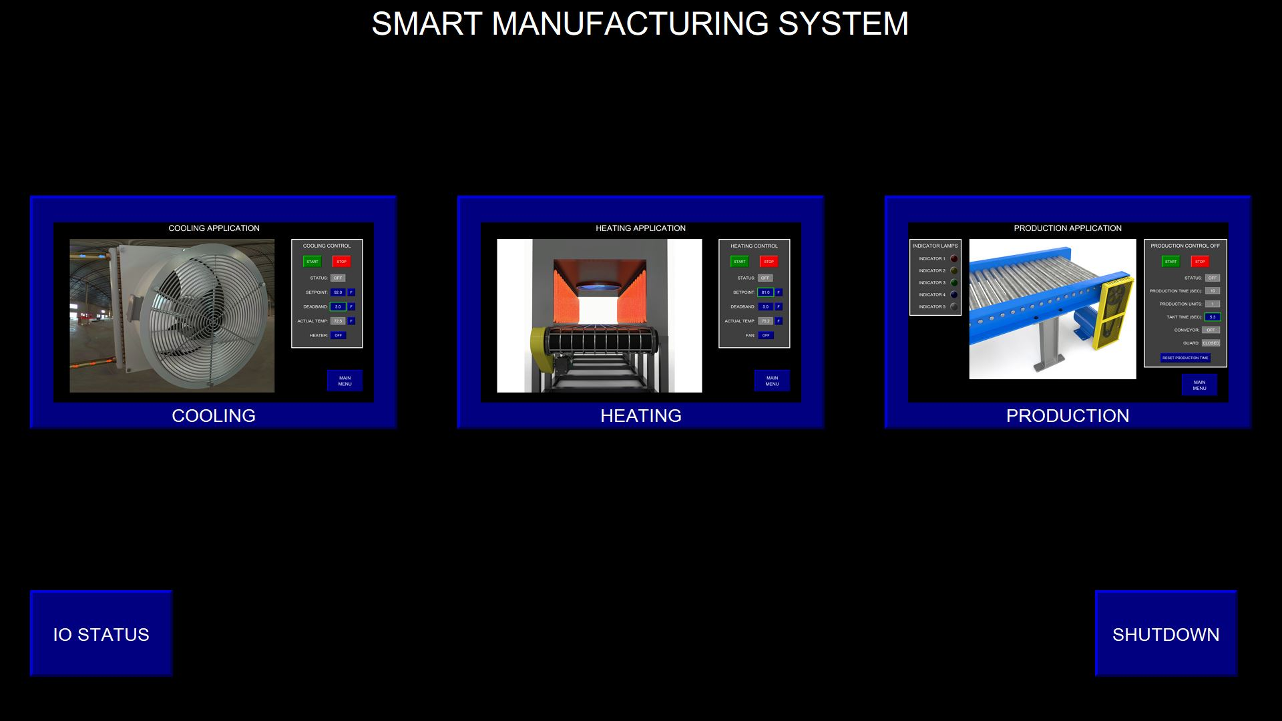
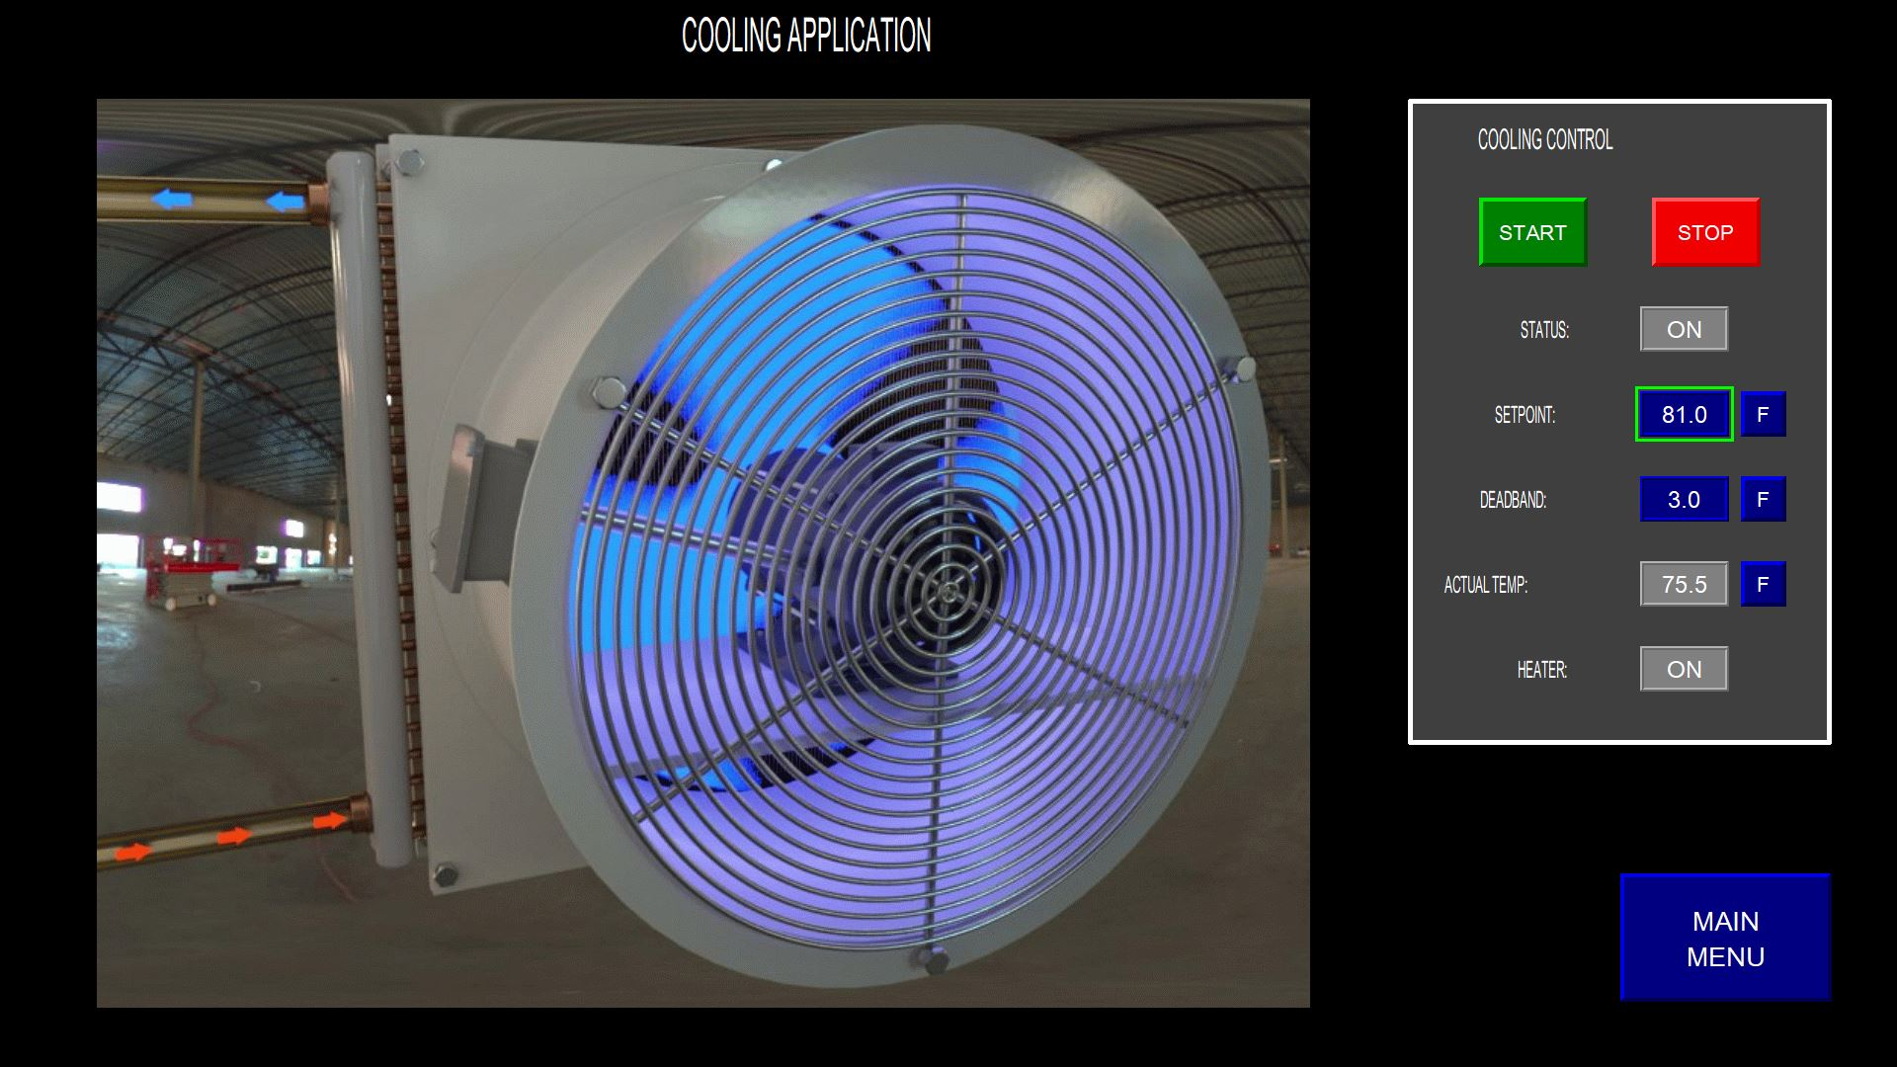
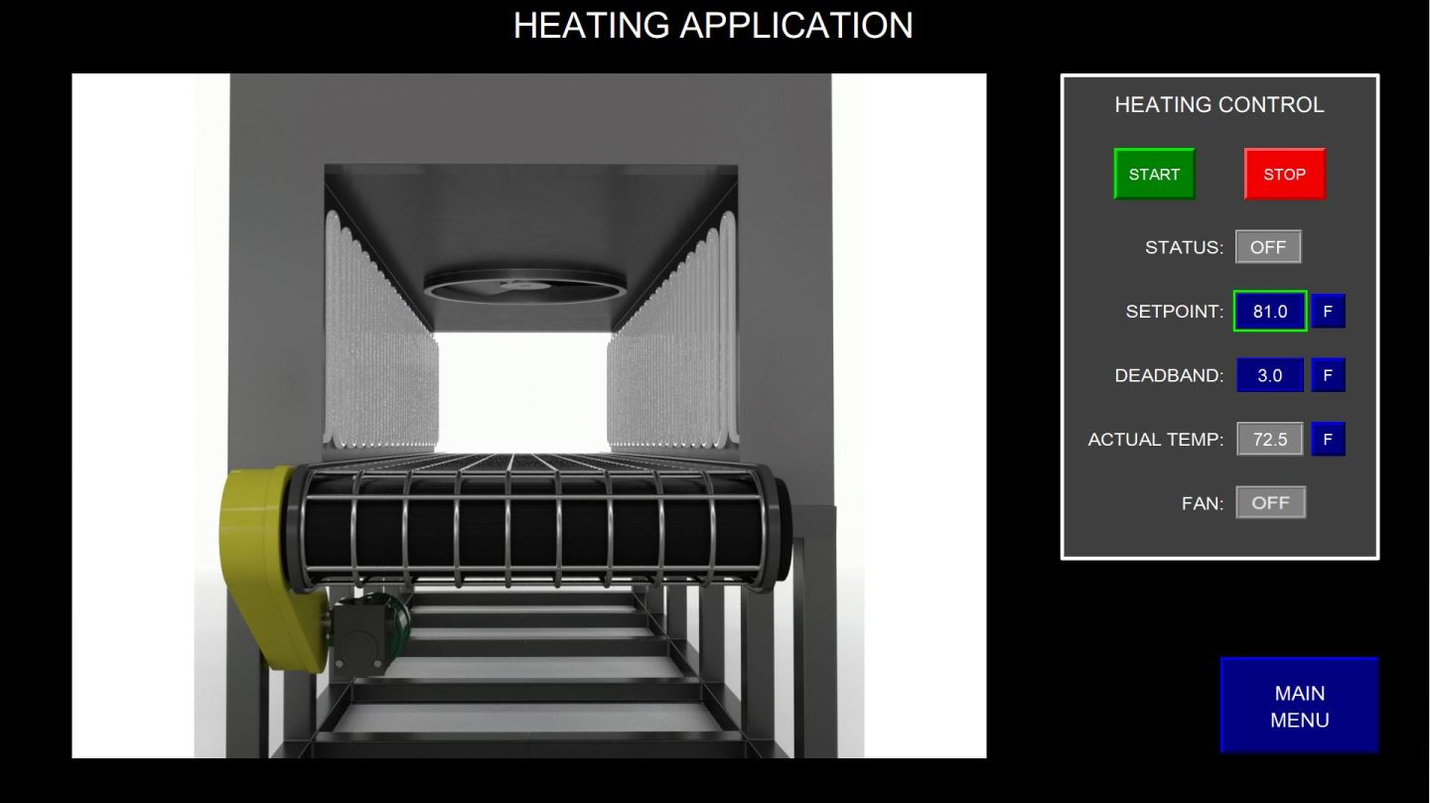
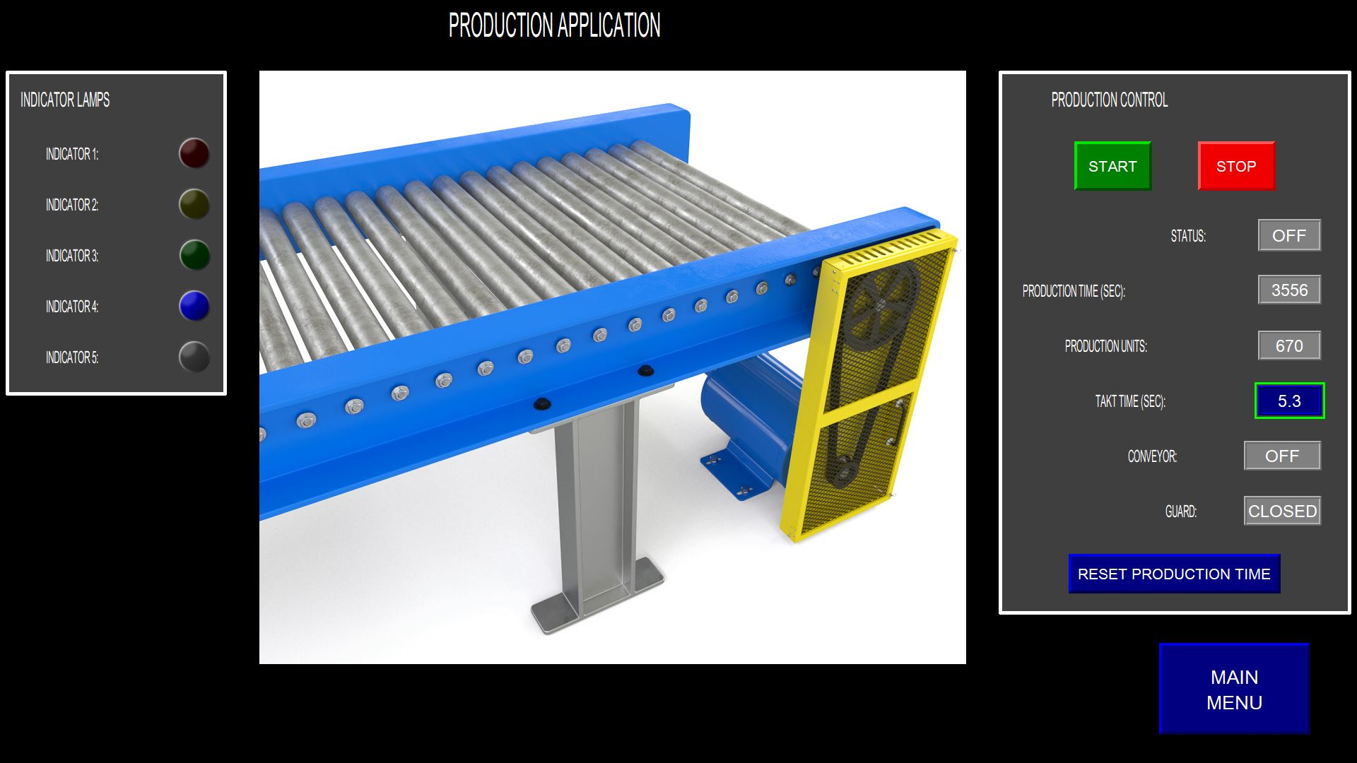
SMLS - PLC HMI Screens
Notes:
We also include these HMI to make sure the students see the sensors and data in the context of industrial applications like the baking oven and conveyor belt.
#

Slide 20
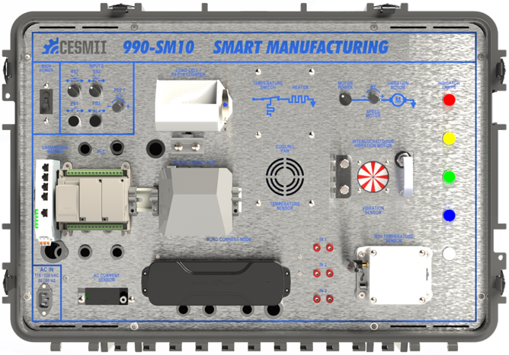
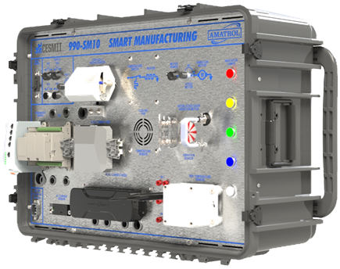

SM Learning System + 2 Day Training
A Standardized Approach to Upskilling a Wide Range of Roles on Smart Manufacturing, IIOT and Industry 4.0 Capabilities
Smart Manufacturing Technologies and Methods
Smart Manufacturing Use Cases
Intro to Smart Manufacturing
  The Value of Smart Manufacturing
  Use of Data for CI/Lean
  Introduction to the SMLS
Data Capture and Information Modeling
  I/O Layer – Purpose & Fit
  Automation to Edge to App
  Wireless Sensors to Edge to App
Automation, IIoT and SM
  Role & function of the PLC, HMI, SCADA
  Role & function of IIoT/SM Platforms
Edge and Cloud
  Connectivity
  Protocols
Cybersecurity
SM Innovation Platform
  Data Collection
  Data Contextualization
  System Design
  Platform Configuration
Production
  Production Monitoring, Asset Utilization, Constraint Analysis, etc. via Counting, Weighing, Timing, Temperature, Speed, Machine State, Cycle Time, Energy Consumption & Management, General Analytics, etc.
  Measuring Non-Productive Time (Uptime Losses, Downtime Losses, Cycle Time Losses, Quality Losses)
  Sustainable Manufacturing
Quality
  Product and Process Quality via Temperature, Weight, Vibration, Time/Speed, etc.
  Manual Data Entry to Augment Automated Data Collection
Maintenance
  Equipment Diagnostics – Basic (Simple Detection that Machine is Down) and Advanced (System Identifies Alarm & Reason Code, Notifies Maintenance)
Smart Manufacturing Learning System - CESMII
Notes:
And we are also developing two days’ worth of curriculum…with hands-on on the SMLS.
#
SM Edge
Windows
Linux
Comms Drivers
PLC
Allen Bradley
Phoenix Contact
Siemens
Applications
Heater Element
Motor with Vibration
Weighing System (Weight, Part Count, etc.)
Current Measurement (Infer Asset Util, Quality, etc.)
Historian (Plant Operations Data Store)
HMI/SCADA Apps (Plant Ops Use Cases)
Sensor to SM Edge to Cloud
Load Cell, Current Transformers, Temperature, Vibration, Humidity, Proximity, Potentiometer, Push Buttons, Selector Switches, Etc.
PLC to SM Edge to Cloud
Load Cell, Current Transformers, Temperature, Vibration, Humidity, Proximity, Potentiometer, Push Buttons, Selector Switches, Etc.

Slide 21

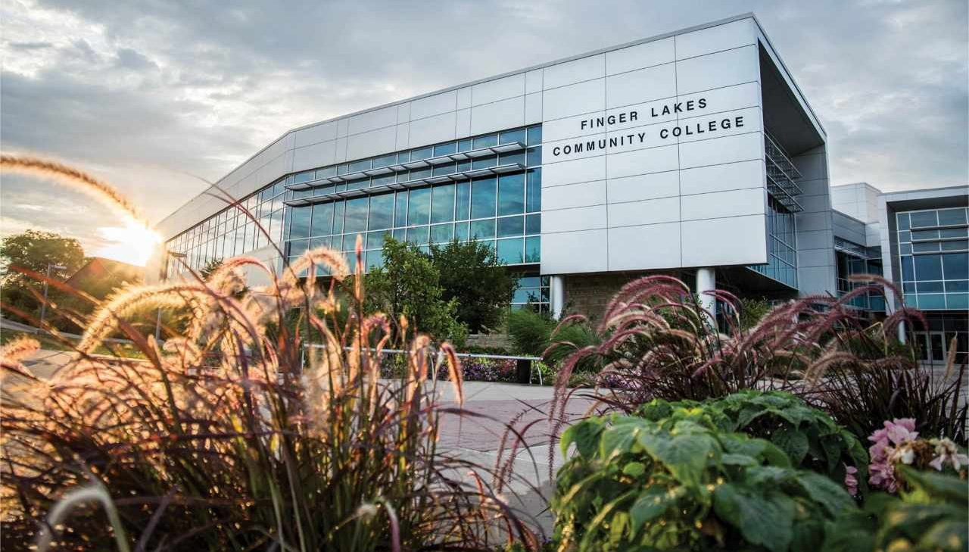
SM Skills Ladder for Undergraduate
and Incumbent Workers at Community College
PROJECT OBJECTIVES:
Develop educational resources that can be used for students at community colleges, and for incumbent workers at high-tech businesses
Accelerate adoption of Smart Manufacturing techniques at small and medium size businesses through targeted co-op experiences (50 Businesses, 270 hours, Hy-Flex class schedule)
RESOURCES:
Collaboration between Finger Lakes Community College, Amatrol, CESMII, and SACA
Among other tools, students will use Amatrol’s SMLS (990-SM10) to learn basic concepts and intermediate skills in use of:
  sensors
  data acquisition
  data analytics
  process modeling and control
  digital twins
  industrial application of machine learning/AI
Resources shared through prior CESMII educational projects will be leveraged
Students and workers will be able to seek relevant SM certifications offered by SACA
Notes:
Finger Lakes is creating curriculum at community college level. Dr Samanta is here…
#

Slide 22
Smart Manufacturing Micro-Credentials
SACA is developing 4 new SM Industry Micro-Credentials that will be aligned with the CESMII curriculum model
Credential #1-Smart Manufacturing Fundamentals
This credential certifies that individuals can:
describe the principles, technologies, & applications of Smart Manufacturing & how they affect the competitive position of manufacturers
safely operate basic smart automation systems that use HMI panels, monitor system operation parameters & energy usage using HMI visualization software, & connect/test to smart devices through point-to-point Ethernet communications.
Credential #2-Smart Manufacturing Data Acquisition
This credential certifies that individuals can:
identify types of manufacturing data & its function
describe how smart manufacturing data is collected & stored
set up & operate a dedicated cloud-based data acquisition system
interface & test analog & discrete sensing devices
configure & test wired & wireless Ethernet communications to sensors
view data stored in a dedicated data acquisition system
Credential #3-Smart Manufacturing Visualization
& Data Analytics
This credential certifies that individuals can:
organize & interpret data using a variety of visualization methods
set up & operate visualization displays using dedicated & controller-based data acquisition systems
set up programmable controllers to collect data
configure Bluetooth technology to transfer information between devices
use OPC server software to facilitate data exchange between a smart device & a database or another smart device
set up Excel databases & use Excel to analyze data
Credential #4-Smart Manufacturing Data Transmission
& Cyber Security
This credential certifies that individuals can:
assess potential cyber security threats to an industrial smart manufacturing system & data transmission methods
use best practices to protect stored & transmitted data against cyber security attacks
respond effectively to cyber security attacks
set up secure industrial local area networks & firewalls
The new micro-credentials will be piloted in industry & schools with SACA members & CESMII members.
Notes:
This year we started working on micro-credentials for SM workforce skills with SACA – the Smart Automation Certificate Alliance.
SACA already has > 50 credentials and micro-credentials >26,000 credentials issued to individuals.
We are adding four SM credentials this year and we are talking about possibly 3 more next year.
#
About SACA
> 300 Total Member Institutions > 50 credentials and micro-credentials >26,000 credentials issued to individuals
In Queue…
Smart Manufacturing - Connecting Data, Platforms, Systems and Workers
Smart Manufacturing - Automating and Optimizing Control, Flow and Resource Productivity
Cybersecurity for Integration of Operational Technology & IT

Slide 23

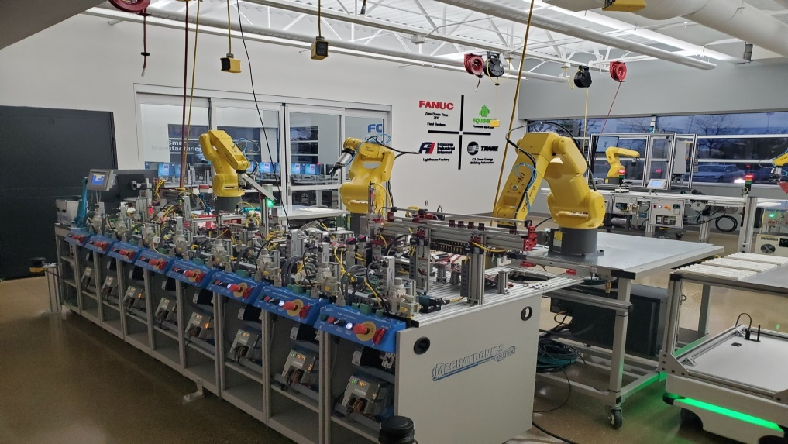






Scalable Smart Manufacturing Workforce Development Community Model
Teacher Training Academy
SACA Certification Courses
Collaborative community network
Digital Twin VR software
Training Assessment can fast track worker learning
Smart Manufacturing Workforce Center
Smart Factory
VR/digital twin software
Notes:
We have an exciting project in Texas establishing an Instructor Academy!
Paul Perkins from Amatrol is here, do you want to say something about the project?
#

Slide 24


Recent Survey of Manufacturers in Texas on Anticipated Skills Need
81.25%
75.86%
68.00%
66.66%
Notes:
We are very pleased that the early results of our survey in Texas shows that manufacturers are very interested in SM skills!
#

Slide 25

Smart Manufacturing Credential Aligned
Community College Instructor Academy
DOE EWD Proposal – Awarded!
Trains college instructors on SM skills throughout the entire State of Texas and across the US.
Expands Instructor Professional Development Academy at Texas A&M University (TAMU).
Develops new instructional modules aligned to the new stackable SM micro-credentials with partners SACA and Amatrol
Educators who attend the Academy will engage in hands-on competency exercises using the CESMII-Amatrol SM Learning System (SMLS).
The participating instructors will be provided a variety of materials and training on how to use them to prepare their future students for SACA certifications.
The project places emphasis on working with community colleges at disadvantaged communities (DACs)
Instructor Academy
becomes a hub
for SM Skills in the region
Notes:
We have a new project that was just awarded by the DOE for next that will expand on the Instructor Academy which becomes a hub for SM Skills in the region.
#

Slide 26






SM Curriculum, Resources -> Education Programs
SM Curriculum and Resources
SM Hardware and Simulators
SMIP Software Platform, Apps
Interoperability Standard (Defacto) for Smart Manufacturing
SM Profile-Based API, SM Profile-Based Data Ingestion & Contextualization
SM Profile-Based Workflow Orchestration
Dev Competency Requirements and BOK for SM Credentials
SM Credential Aligned Instructor Academy, TAMU, Amatrol, SACA
Package Curriculum Materials and Hands-On Exercises
Signup Tech/Community College Professors
Equip SM Lab at Instructor Academy
SM Ready
Tech College
Training Programs
Run Train the Instructor Program
Notes:
We are at a point where we are leveraging the resources we have create… like the curriculum created by the Festo and West Virginia project… the Amatrol SMLS, the SACA credentials, and the SMIP… all of these resources are coming together in projects like the Instructor Academy in Texas!
#
Universities are going to teach how to make reusable Model and put in Library
Data Science vs Data Analytics
Industry needs to teach Anchor College to teach Community College Professors.
At Workroce Level – Create anchor of Community College
#

Slide 27

Credits
B.S. in Automation Leadership
Take your education and experience in automation and mechatronics to the next level. UW-Stout’s B.S. Automation Leadership provides technology-driven, future-focused students a pathway to leadership in Industry 4.0.
The only degree of its kind, offering courses aligned with Smart Automation Certification Alliance (SACA) standards plus leadership and management training to enhance your industry-recognized credentials.
19
UW-Stout Automation Leadership Courses
Digital Transformation
Internet of Things in Operations
Project Management
Organizational Leadership
Lean Manufacturing
Automation Leadership Internship
Automation Leadership Capstone
40
40
21
120
Notes:
This is an example… a program that offers an innovative approach to university programs that builds on micro-credentials.
Offers a new Pathway to a 120 credit degree in BS in Automation Leadership.
Today many workers do not finish aprenticeships because they start working. With this new program. They can pick up later.
If student/worker does not finish the program or apprenticeship… they still have the micro-credentials.
For SACA Core credentials/40 credits: All 15 of the required certifications in the top section must be earned. Then 2 out of the 4 electives in the bottom section must be earned.
For SACA Professional/21 credits: Any 7 out of that list of 14 must be earned
#
SACA Certifications Key to New Automation Leadership Degree – SACA
B.S. in Automation Leadership
B.S. Automation Leadership | University of Wisconsin - Stout (uwstout.edu)
About SACA
> 300 Total Member Institutions > 50 credentials and micro-credentials >26,000 credentials issued to individuals

Slide 28
Credits
YEARS 1-2 REQUIRED CREDENTIALS (15 credentials)
C-101 Certified Industry 4.0 Associate-Basic Operations
C-102 Certified Industry 4.0 Associate-Advanced Operations
C-103 Certified Industry 4.0 Associate - Robot System Operations
C-201 Electrical Systems 1
C-202 Electric Motor Control Systems 1
C-203 Variable Frequency Drive Systems 1
C-204 Motor Control Troubleshooting 1
C-205 Sensor Logic Systems 1
C-207 Programmable Controller Systems 1
C-208 Programmable Controller Troubleshooting 1
C-209 Pneumatic Systems 1
C-212 Ethernet Communications 1
C-213 Smart Sensor and Identification Systems 1
C-214 or C-104 Smart Factory Systems 1
C-216 Robot Systems Integration 1
Year 1-2 Electives (choose 2 of 4)
C-206 Electrical System Installation 1
C-210 Mechanical Power Systems 1
C-304 Pneumatic Troubleshooting 1
C-255 Hydraulic Systems 1
B.S. in Automation Leadership
Take your education and experience in automation and mechatronics to the next level. UW-Stout’s B.S. Automation Leadership provides technology-driven, future-focused students a pathway to leadership in Industry 4.0.
The only degree of its kind, offering courses aligned with Smart Automation Certification Alliance (SACA) standards plus leadership and management training to enhance your industry-recognized credentials.
19
40
40
21
120
Notes:
For SACA Core credentials/40 credits: All 15 of the required certifications in the top section must be earned. Then 2 out of the 4 electives in the bottom section must be earned.
For SACA Professional/21 credits: Any 7 out of that list of 14 must be earned
Yes, the degree is a BS in Automation Leadership. It’s a 120-credit degree program.

Slide 29
Credits
B.S. in Automation Leadership
Take your education and experience in automation and mechatronics to the next level. UW-Stout’s B.S. Automation Leadership provides technology-driven, future-focused students a pathway to leadership in Industry 4.0.
The only degree of its kind, offering courses aligned with Smart Automation Certification Alliance (SACA) standards plus leadership and management training to enhance your industry-recognized credentials.
19
40
General Education Courses
(Transfer up to 27 credits)
40
21
120

Slide 30
Credits
B.S. in Automation Leadership
Take your education and experience in automation and mechatronics to the next level. UW-Stout’s B.S. Automation Leadership provides technology-driven, future-focused students a pathway to leadership in Industry 4.0.
The only degree of its kind, offering courses aligned with Smart Automation Certification Alliance (SACA) standards plus leadership and management training to enhance your industry-recognized credentials.
19
YEARS 3-4 REQUIRED CREDENTIALS (choose 7 OF 14)
C-211 Industry 4.0 Total Productive Maintenance Management (C-101, 102)
C-305 Industrial Electronic Systems 1 (pre-req: C-201, 205)
C-308 Variable Frequency Drive Systems 2 (pre-req: C-203, 204)
C-309 Programmable Controller Systems 2 (pre-req: C-207, 208)
C-310 Ethernet Communications 2 (pre-req: C-212)
C-312 Robot Systems Integration 2 (pre-req: C-216)
C-313 Smart Factory Systems 2 (pre-req: C-214 or 104)
C-359 Programmable Controller Systems 3 (pre-req: C-309)
C-362 Machine Vision Systems 1 (pre-req: C-201, 216)
C-306 Industrial Electronic Systems 2 (pre-req: C-305)
C-307 Electronic Systems Installation 1 (pre-req: C-206)
C-358 Autonomous Mobile Robot Systems 1 (pre-req: C-212, C-207)
C-360 Motion Control Systems 1 (pre-req: C-359)
C-361 Programmable Conveyor Systems 1 (pre-req: C-214 or 104)
40
40
21
120
Notes:
For SACA Core credentials/40 credits: All 15 of the required certifications in the top section must be earned. Then 2 out of the 4 electives in the bottom section must be earned.
For SACA Professional/21 credits: Any 7 out of that list of 14 must be earned
Yes, the degree is a BS in Automation Leadership. It’s a 120-credit degree program.
# About SACA
> 300 Total Member Institutions > 50 credentials and micro-credentials >26,000 credentials issued to individuals

Slide 31



SM Curriculum, Resources -> Education Programs
SM Software Platform, Apps
Hardware and software resources for education.
SM Role-Based Curriculum
SM Education Catalog
SM Hardware and Simulators
Curriculum Guidance – curriculum materials, exercises, datasets.
Learn SM from CESMII-Endorsed education partners!
http://www.cesmii.org/education
Notes:
This is how all it all ties together! The curriculum and equipment resources we have created come together as they are implemented into education programs by our partners!
We are looking to recruit more Community Colleges to add SM skills to their training programs. We think these affordable solutions will be key not only because Community Colleges can afford but more importantly because they represent solutions that SMMs can afford to implement!
We need a new workforce with skills to help get SM into the SMMs.
#
The simulations/VR systems should provide data and simulate real industrial assets and situations where equipment is not operating at optimal conditions and students need to figure out from data analysis how to make adjustments to the simulated asset to correct problems or optimize the process. A simulator allows the students to make adjustments to industrial processes without the potential loses related to working with real production assets.
The Educational SM Apps should consume data from real assets, simulators, or manual worker entry to give students experience with scenarios they would encounter in real production. Scenarios that create insights from the collected data and is used in analysis that leads to finding problems or recommending process improvements.

Slide 32
Smart Manufacturing Education Resources
How can educators introduce concepts and hands-on activities to students on SM skills for manufacturing jobs?
Visit and learn from CESMII SM Innovation Centers where technology and techniques are demonstrated.
Support Micro-Credentials like SACA and prepare students to test for these credentials.
Leverage hardware and software resources for education available through CESMII and partners.
Learn SM from CESMII-Endorsed education partners!
Programs and Resources for Educators:
Curriculum Guidance – curriculum materials, exercises, code, & datasets.
Hands-On Training Resources - hardware kits, software & curated exercises.
Endorsed Education Program – Review and certification of Smart Manufacturing education courses/programs.
http://www.cesmii.org/education
Notes:
Make sure to check out the education resources at CESMII. You can visit our website for more information!
#

Slide 33


Thank you.
http://www.cesmii.org/education education@cesmii.org

