Slide 1
Impacting Regional Ecosystems through CESMII’s National Network of SM Innovation Centers
Howard Goldberg
COO, CESMII
Craig Dory
Director, SMIC at Rensselaer Polytechnic Institute
Nick Barendt
Director, SMIC at Case Western Reserve University
Ragu Athinarayanan
Director, SMIC at Purdue University

Slide 2
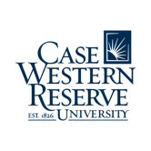
What’s a SMIC?
Smart Manufacturing Innovation Center
SMICs are a network of industry-centric centers-of-excellence throughout the U.S. focused on leading that industry’s ecosystem in the field of Smart Manufacturing.
Enable SM access for small, medium and large businesses
Demonstrations, training, and outreach
National reach with a regional impact
WE CURRENTLY HAVE 7 SMIC’S THROUGHOUT THE COUNTRY

Slide 3
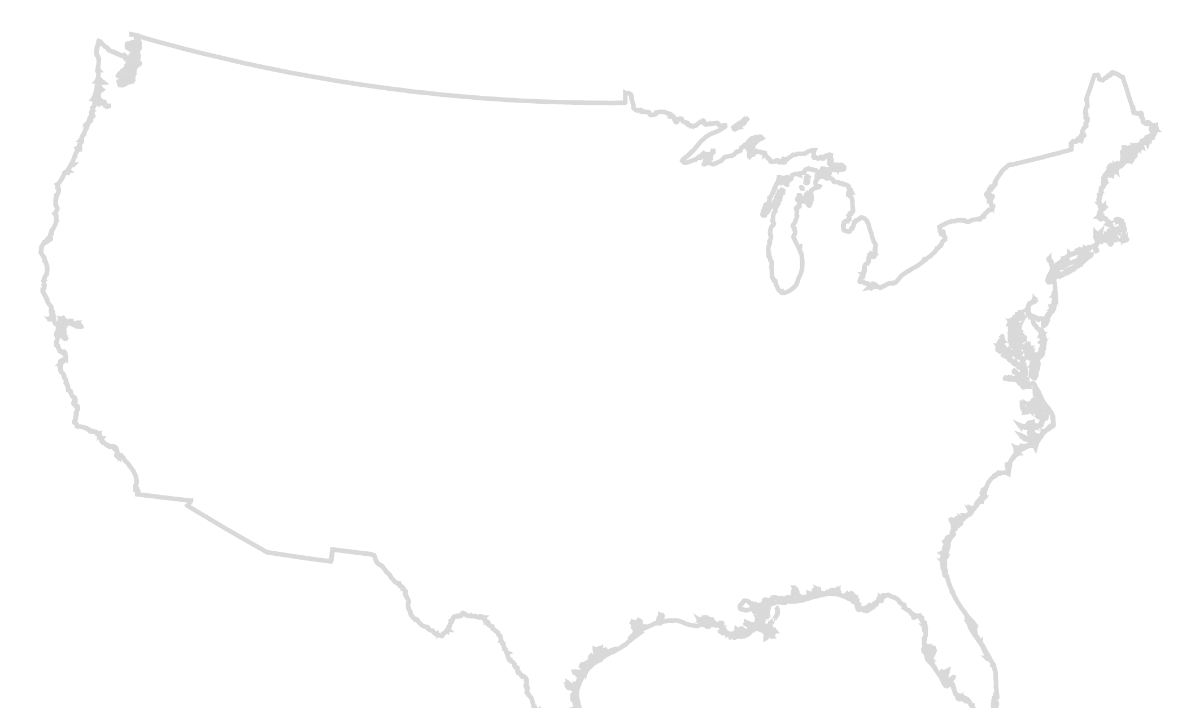
Oregon State University
Food & Bev, Aerospace, SMMs
In addition to our 7 SMIC locations, we have 10 satellite locations that provide extended support. This allows the CESMII footprint to extend even
further supporting industry & technology needs.
Support SMMs on their SM journey
SM Training for Automotive, Food, CPG and Pharma
CNC/Machining, Discrete Mfg
Bennit AI
MAGNET
TeamNEO
Cleveland St. Univ.
SM training for SMMs
ThinkIQ
Machine Vision-Based Digital Twinning
West Virginia University
AI to improve manufacturing productivity (Microsoft, WVU, UNF)
AI/ML for Energy Efficient Manufacturing; Advanced Sensors, Controls, Platforms and Modeling for development and validation of SMIP capabilities
Pulp/Paper Industry, Nonwoven Material Industry, Bio Mfg Industry
El Camino College
EWD Training Center – Aerospace & Machining Industries
SM Innovation Centers (SMICs)
CESMII Headquarters
SMIC Satellites
University of North Florida
Advanced Manufacturing International Inc. (AMI)

Slide 4
555+ years
of Smart Manufacturing experience within industry, academia, SMMs to large manufacturers, and the entire manufacturing ecosystem.
A Smart Manufacturing subject-matter expertise portfolio that adds depth of bench to CESMII and provides additional areas of:
CNC and legacy equipment automation, future SM workforce training, MEPs, SMMs, Industrial engineering, advanced and additive mfg, Pulp & Paper, Non-wovens and textiles manufacturing, Biomanufacturing, Mechanical engineering, advanced machining, metallurgy, Chemical process control and modeling, Economic and workforce development, IACs, Industrial vision systems and data analytics, Metals and metal processing, SMM training, Business Assessments & Roadmapping, automotive, industrial informatics, data ontologies, democratization of AI/ML, digitalization of supply chains

Slide 5
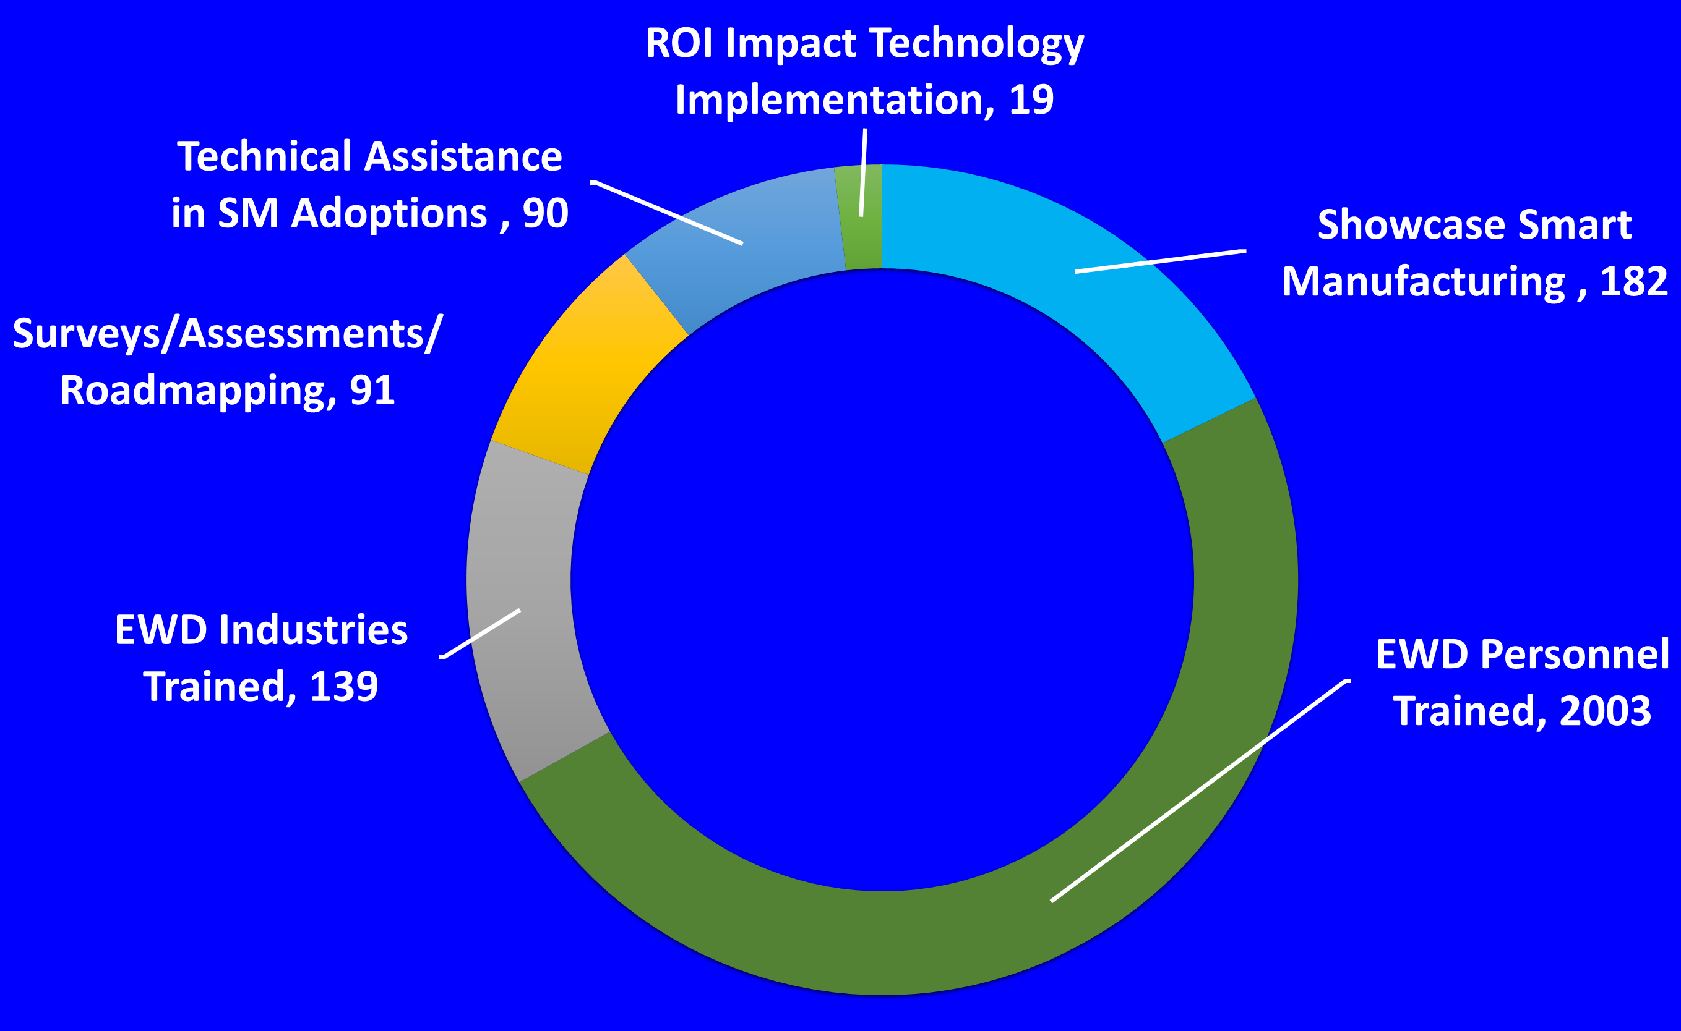
V
SMICs Ecosystem Impact to Industry!
Notes:
SMICs form a supply-chain testbed: ecosystem of manufacturing assets connected to a common platform (SMIP).
In the past year, CESMII has grown its SM Innovation Centers (SMICs) from three to seven and leveraging them to partner with MEPs to increase SMM engagement. Additionally, the OSU satellite has introduced SM elements to the DOE IAC program for SMM engagement. SMICs help demonstrate and disseminate technology and training at both regional as well as national levels, thereby impacting energy productivity improvements for a variety of industry verticals and supply chains
Purdue SMIC has a West Virginia Univ satellite with a SOPO milestone focused on the application of AI/ML in Smart Manufacturing for a resilient supply chain network use case.
WVU satellite is lead by Thorsten Wuest a co-author of “Digital Supply Networks” book

Slide 6
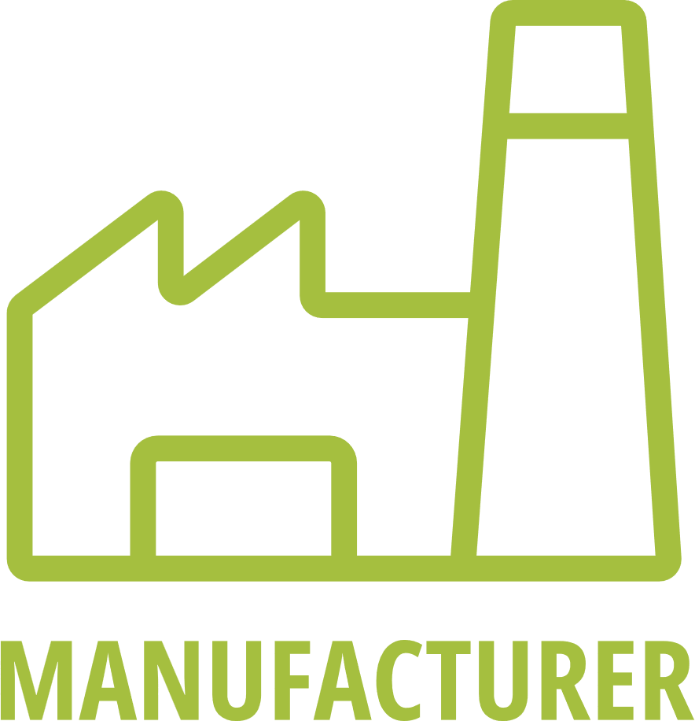
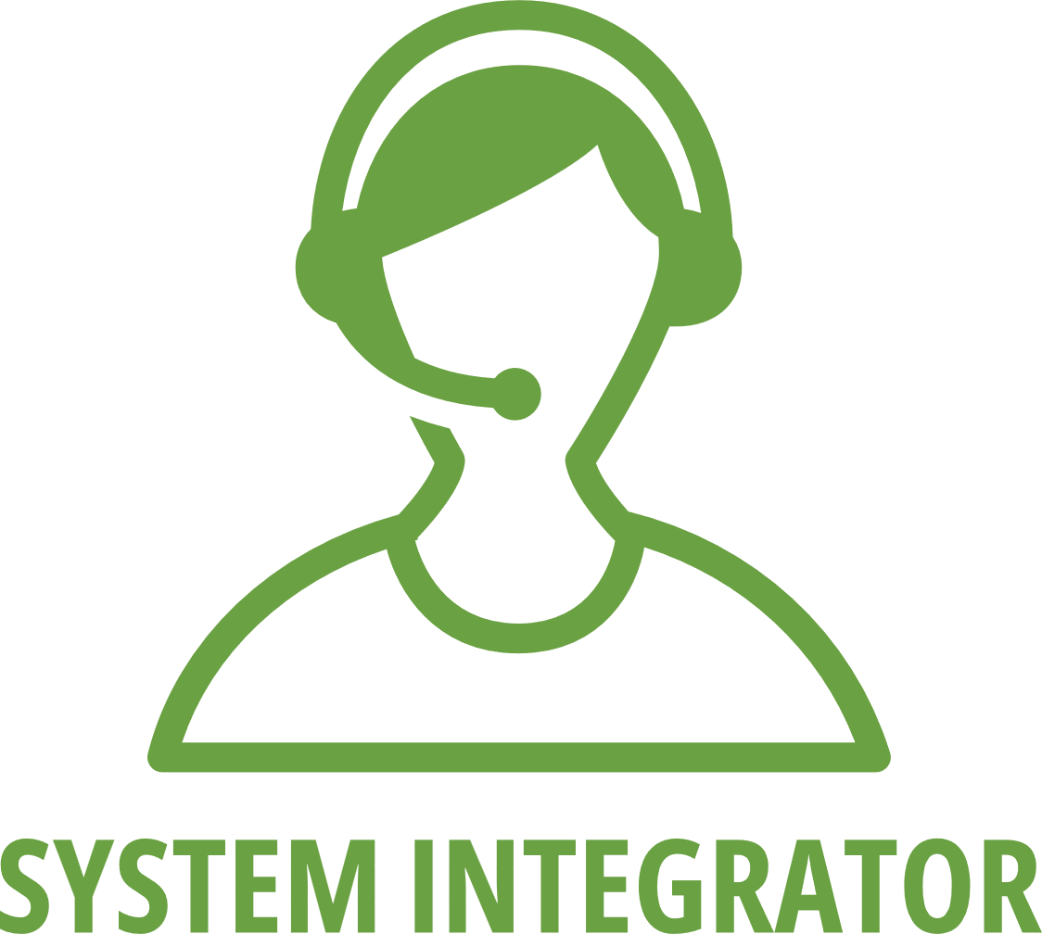
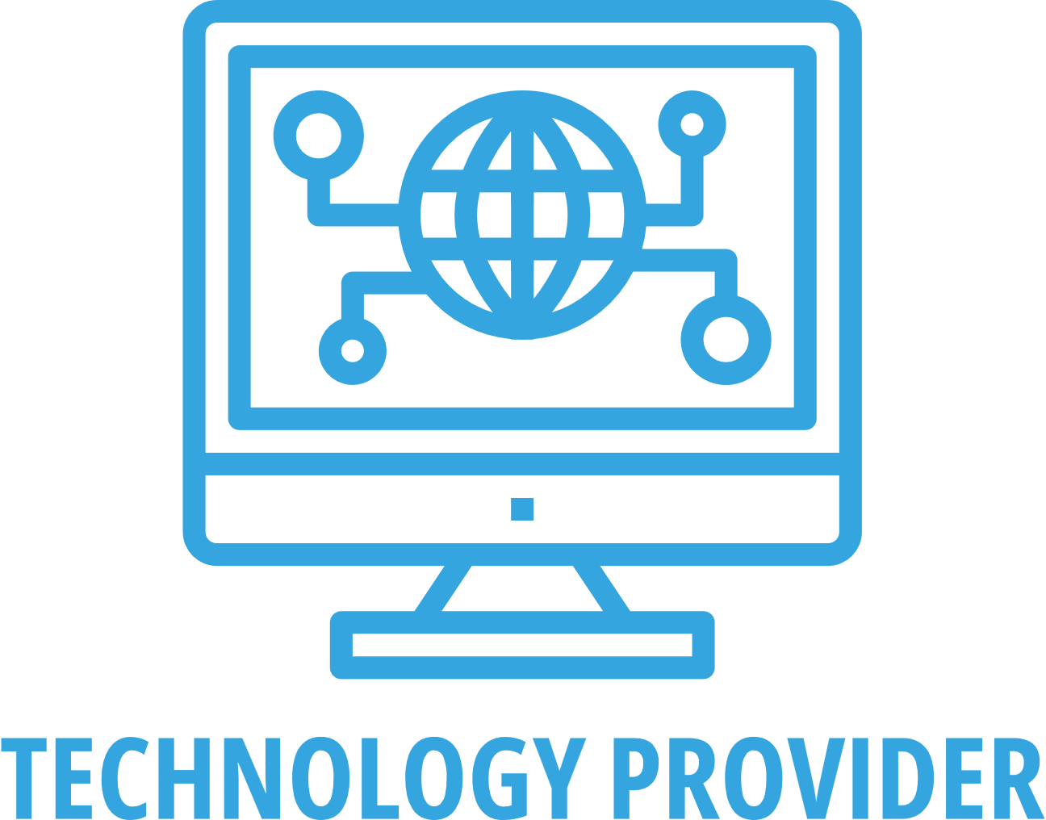
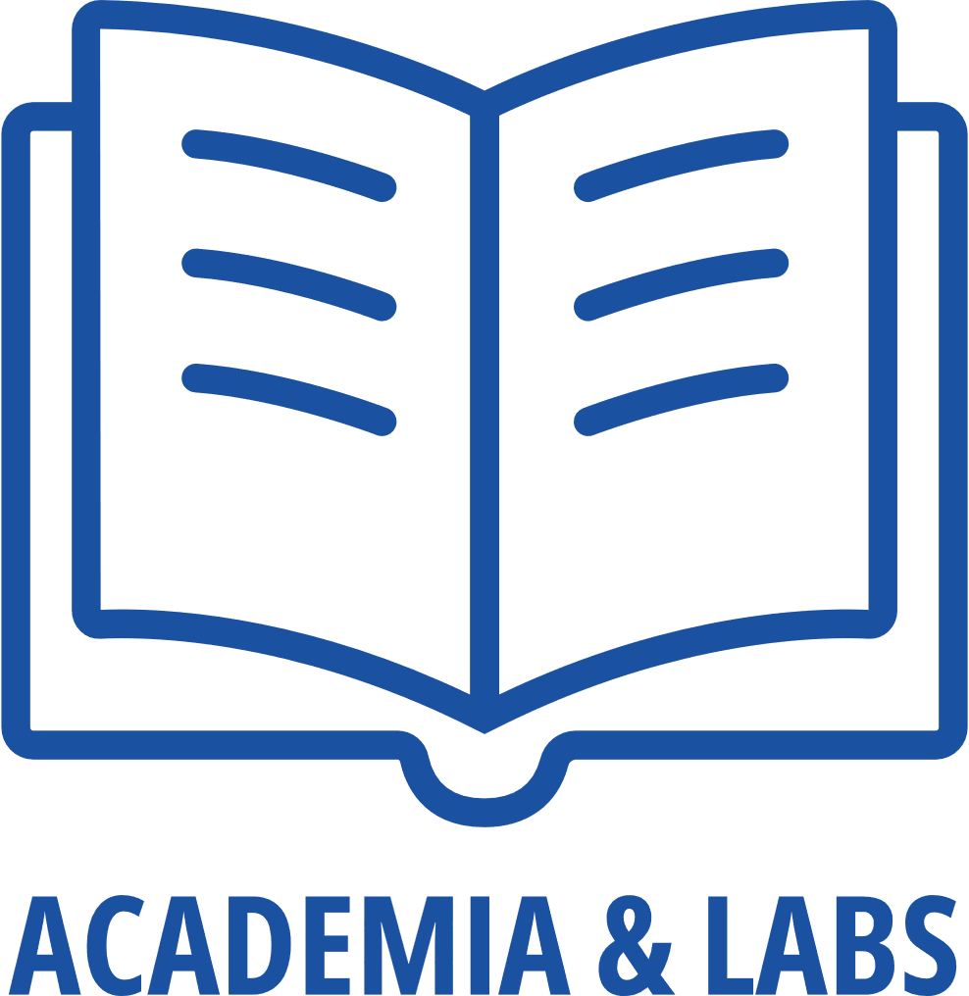
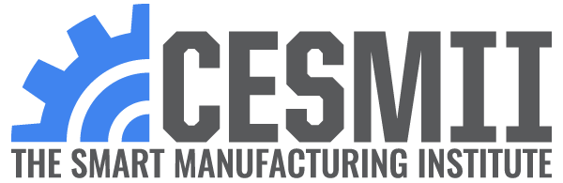
Engage
with our SMICS
Bring an innovation challenge to the SMIC
Explore EWD programs for training your SM workforce
Leverage SM college education programs to supply your future workforce needs
Engage, train, be trained, and become the resident domain expert
Implement your solutions at the SMIC
Provide your sensors, hardware, assets to the SMIC
Collaborative training infrastructure for demonstrating
Notes:
Affinity Group Inquiries:
michael.maziarz@cesmii.org
SMIC Connection Inquiries: dale.turner@cesmii.org to engage with your local MEP
Membership Inquiries: steve.winski@cesmii.org

