Slide 1
AMMTO Peer Review
2023 May 17

Slide 2









mission. strategy. role.
CESMII represents the
voice of manufacturing;
engaging the smart
manufacturing ecosystem
through a membership model
Driving the next wave of manufacturing productivity, energy productivity and competitiveness through smart manufacturing innovation.
Manufacturers
Small, Medium & Large
System Integrators
& Consultants
2017
$140M+
Improve energy productivity through sensing, control, modeling, analytics &
platform technologies
Founded by the D.O.E
Private/public partnership
Machine
Builders
Technology
Providers
How.
Fund the Innovation and R&D necessary to dramatically reduce the cost & complexity of using real time operations data to drive revenue & cost improvements and generate cash.
Academia
& Labs
2
Notes:
Who we are
Founded & funded by the US .gov in 2017
Private/public partnership - $140M+ over 5 years
We represent the ‘Voice of Manufacturing’
NOT a Vendor, NO product to sell
We engage the SM Ecosystem through a membership model
Fund REAL Manufacturing Innovation & Research that enables the Democratization of Smart Manufacturing
Technology (Digital Transformation)
Education & Workforce Development (Cultural Transformation)

Slide 3
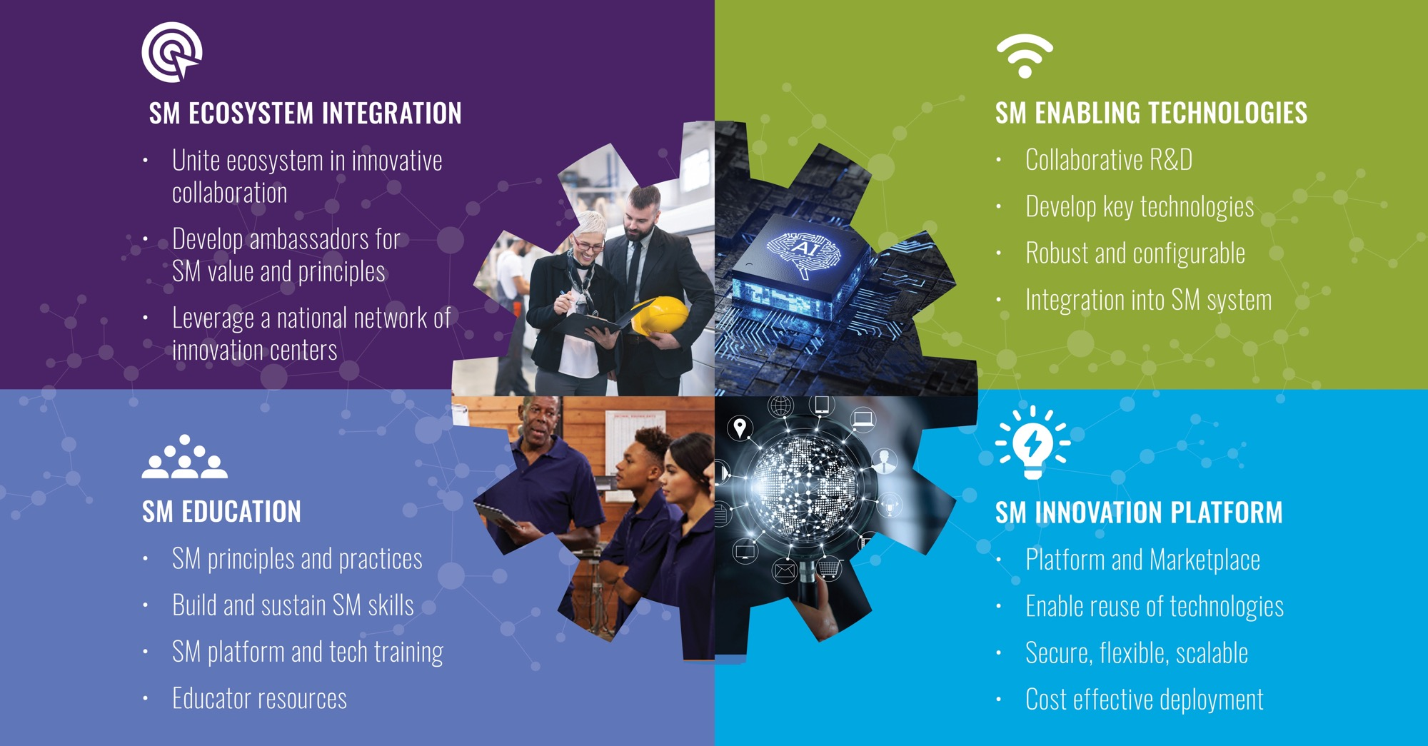
CESMII’s Integrated Roadmap Pillars

Slide 4
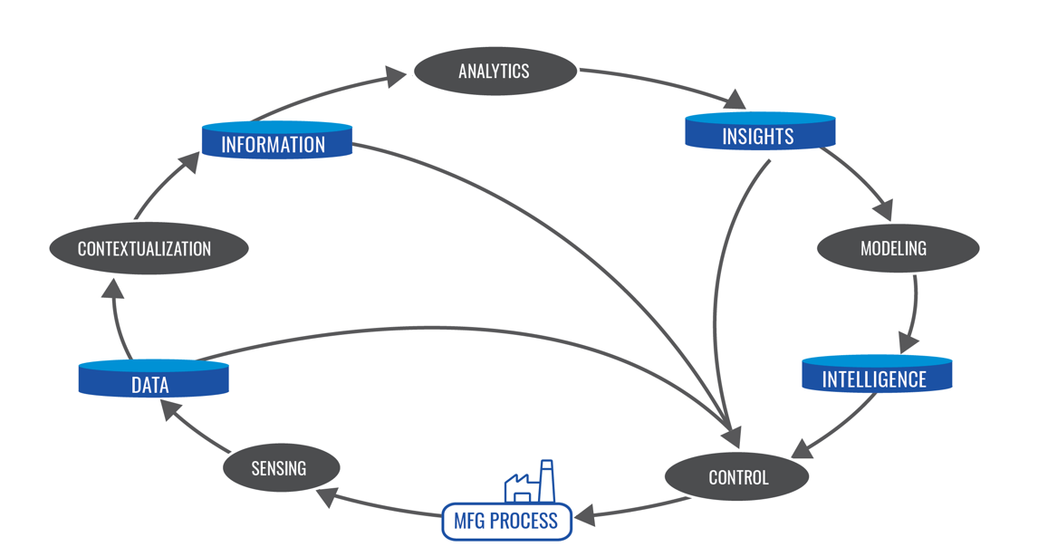

SM Technology Building Blocks and Information Flow
Diagnostic
Predictive
  Structured Information Models
  that enable movement of
  data-in-context and
  hence interoperability
  of components
Descriptive
Prescriptive

Slide 5
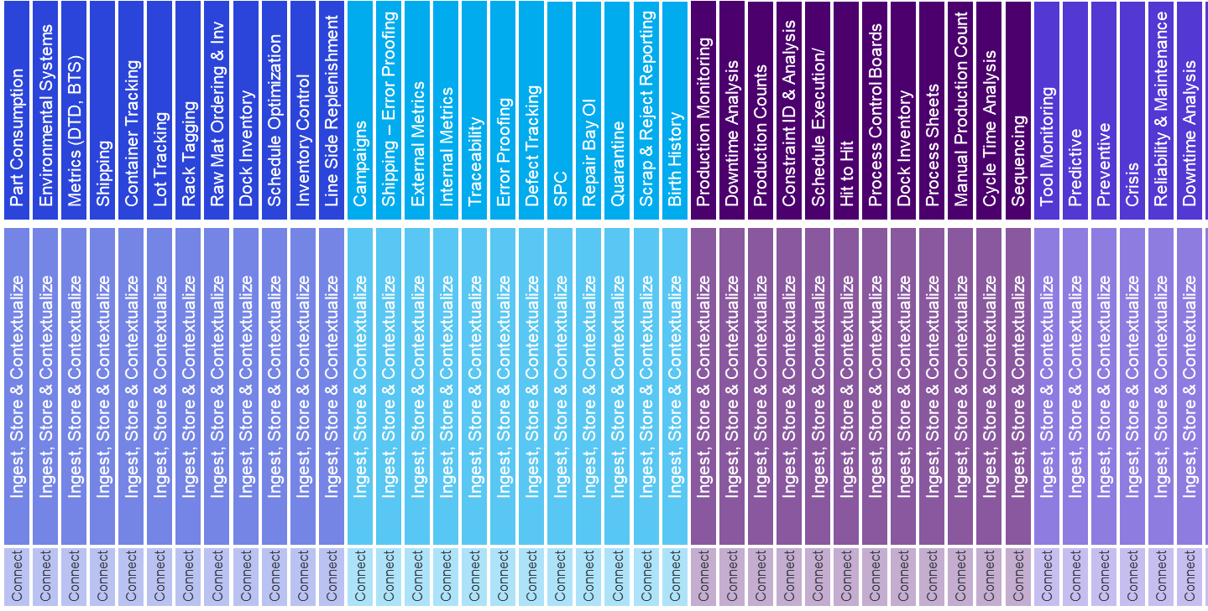














A Sustainable and Future-Proof Strategy for SM
Interoperability Demands an Information Model-Driven Architecture
Applications
Smart Manufacturing Marketplace
SM Apps
SM Profiles
Use and Transform Data to Create Value
Consumes the interface to allow independent development.
CESMII SM Specification
Data Ingestion & Contextualization & Storage
Contextualize, Store
and Manage Data
Defines the object model and interface
CESMII SM Specification
Edge
Connect, Extract and Secure Raw Data
CESMII SM Specification
Determines what data to collect and how
Unstructured Data
Smart Devices
Human Input
Automation Systems
Manufacturing Software Systems
Audio
Video
C/T Sensor
VFD
Wearable
Manual Data
Robot
Machine Tool
PLC
DCS
DB/Historian
HMI/SCADA
Mfg Software

Slide 6

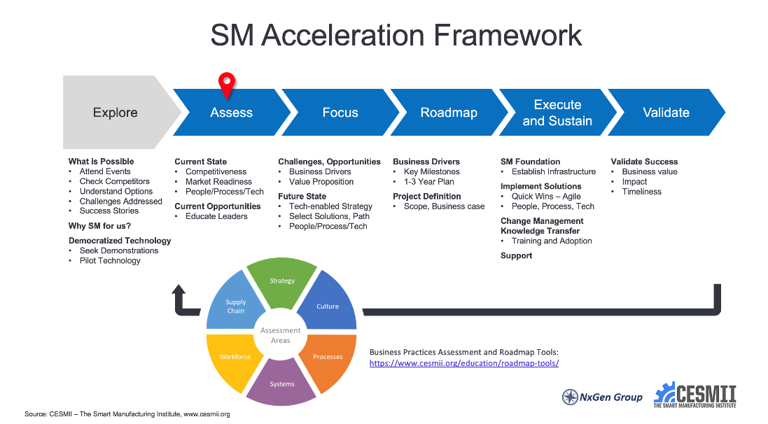
Smart Manufacturing Roadmap Tools
The CESMII Acceleration Framework helps you establish
a strategic and tactical roadmap specific to your business.
This is your no-cost starting point.
Complete this assessment to gain
better insight into your operations
identify areas for improvement.
START HERE

Slide 7
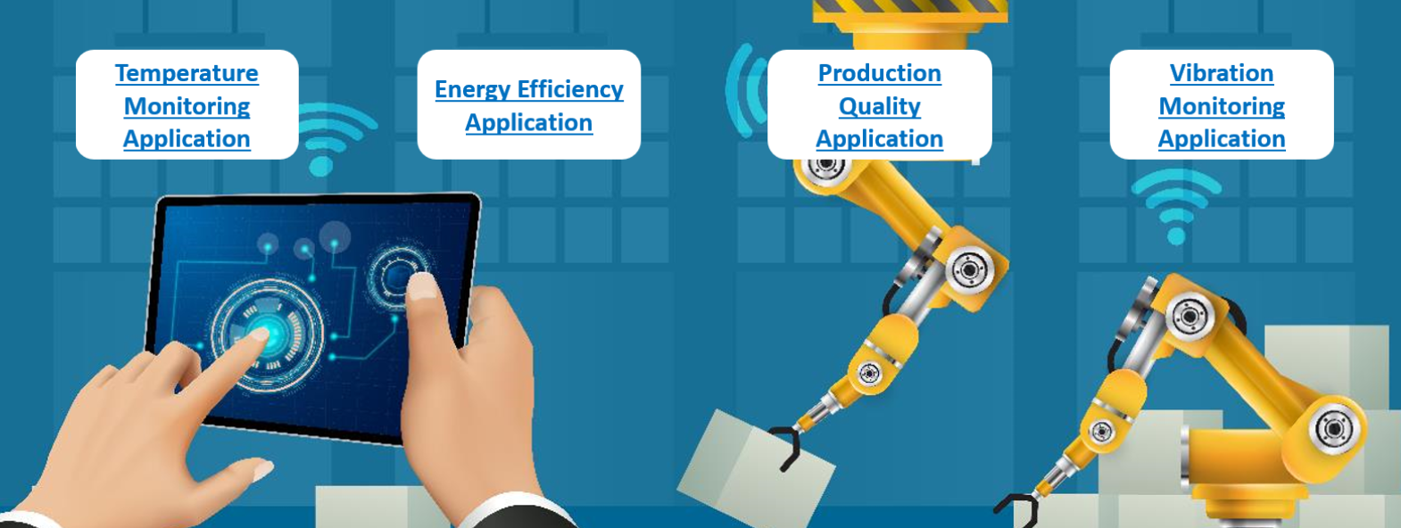
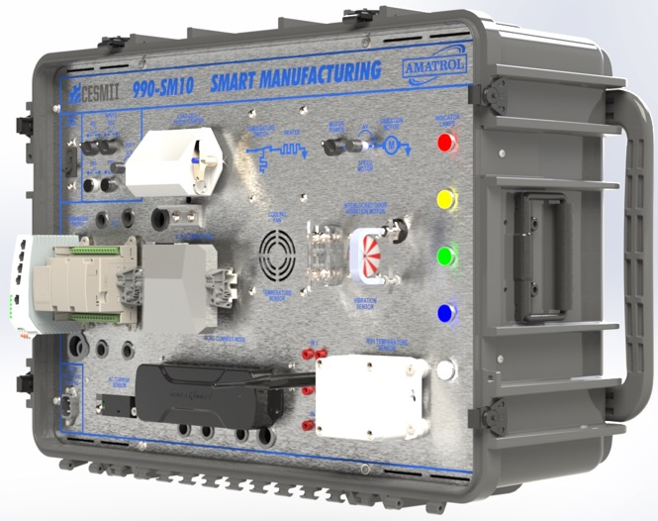
SM Learning System - Hardware Kit
SM Edge
Windows
Linux
Comms Drivers
Applications
Heater Element
Motor with Vibration
Weighing System (Weight, Part Count, etc.)
Current Measurement (Infer Asset Util, Quality, etc.)
Historian (Plant Operations Data Store)
HMI/SCADA Apps (Plant Ops Use Cases)
Sensor to SM Edge to Cloud
Load Cell, Current Transformers, Temperature, Vibration, Humidity, Proximity, Potentiometer, Push Buttons, Selector Switches, Etc.
PLC to SM Edge to Cloud
Load Cell, Current Transformers, Temperature, Vibration, Humidity, Proximity, Potentiometer, Push Buttons, Selector Switches, Etc.
PLC
Allen Bradley
Phoenix Contact
Siemens

Slide 8







































































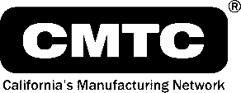













































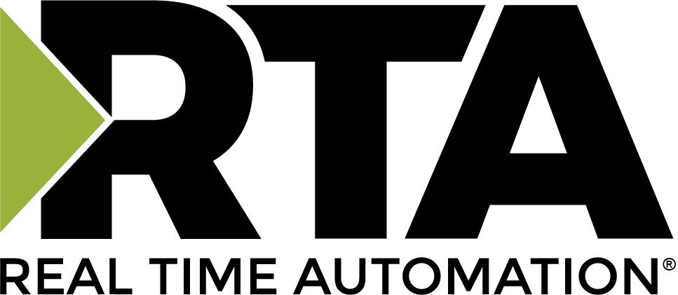


An ecosystem of ~180 Collaborating Members

Slide 9





Excellence in Execution Strategy & Aligning with Our Metrics
❶ 15% improvement in energy efficiency in first-of-a-kind demonstrations
at manufacturing plants or of major processes within 5 years
❷ 50% reduction in cost and time to deploy SM in existing processes
within 5 years
❸ Significant industry adoption of SM technology within 5 years
❹ Sustainable portfolio of business, technology, research and development, and workforce development activities that directly replaces initial Federal funding within 6 years
❺ 50% improvement in energy productivity within 10 years
❻ SM Workforce Capacity in the US will be Increased – 2X by 2020 & 5X by 2030
Focus on Industry Relevance and the Translatability/Re-Use of Project Outcomes for Many Other Manufacturers
Primary Impact
Secondary Impact
Create & Scale SM Capabilities
Implement SM Capabilities
SM Enabling Technologies (ASCPM*)
Advancing
SM Technologies
Advance SM Practices & Knowledge
Implement & Validate
SM Capabilities
Pilot SM Technologies, Tools and Practices
Enabling R&D Projects
Platform &
Capability Projects
Education & Workforce Development
SM Innovation
Projects
Application
Projects
❶ ❷ ❸ ❹ ❺ ❻
❶ ❷ ❸ ❹ ❺ ❻
❶ ❷ ❸ ❹ ❺ ❻
❶ ❷ ❸ ❹ ❺ ❻
❶ ❷ ❸ ❹ ❺ ❻
SM technology gaps: sensors, AI/ML, controls, modeling, 5G…
Develop core technologies: Innovation Platform, Profile Designer, Marketplace and tools
Develop SM education content: train, equip & certify SM practitioners, citizen technologists…
Implementation of SM innovations leveraging the SMIP, Profiles and Apps…
Free, pre-production use of CESMII capabilities for Proof-of-Concept development
*ASCPM = Advanced Sensors, Controls, Platform & Modelling for Manufacturing

Slide 10
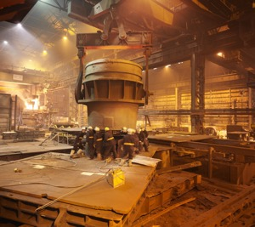


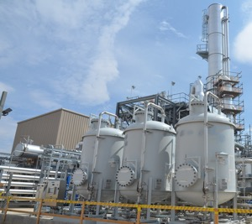


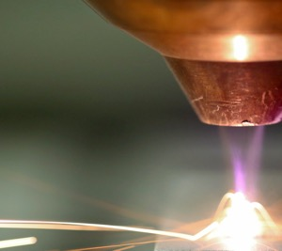

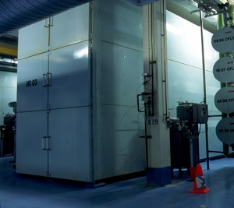
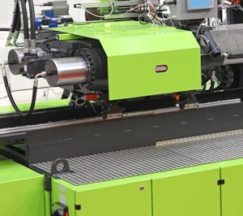




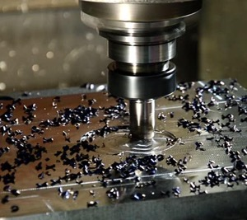





Industries We Impact
Steel
Agriculture
Cement
Chemical
Aerospace
Pulp & Paper
Additive Mfg
Pharma
Thermal
Treatment
Injection
Molding
Automotive
Supply Chain &
Warehousing
Metal
Food
Machine
Tools
Images Courtesy of Creative Commons

Slide 11



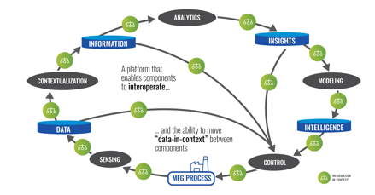
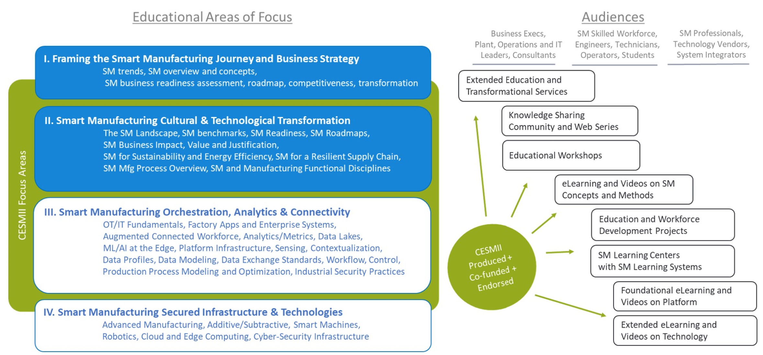



The CESMII Story
1
2
3
Develop SM technologies to solve manufacturing problems
Accelerate SM Adoption
In SMMs and Supply Chain
Upskill the Workforce
Through Education, Training
SM Building Block Technologies
SM Innovation Platform, Profiles, Marketplace
SM Education and Training
Energy Intensive Industries
Small & Discrete Manufacturing
Talent Pipeline & Incumbent Workforce
10-25% reduction in energy
for steel and cement industries
25-50% reduction in SM
implementation costs
6 new curriculums, >6000
students and professionals trained
Energy Productivity
Quality, Yield, Waste
Decarbonization
Performance & Productivity
Implementation Cost/Complexity
SMM & Supply Chain Adoption
Education & Training
Upskilling
SM adoption
Smart Manufacturing Innovation Centers (Dissemination of Technology and Training)

Slide 12
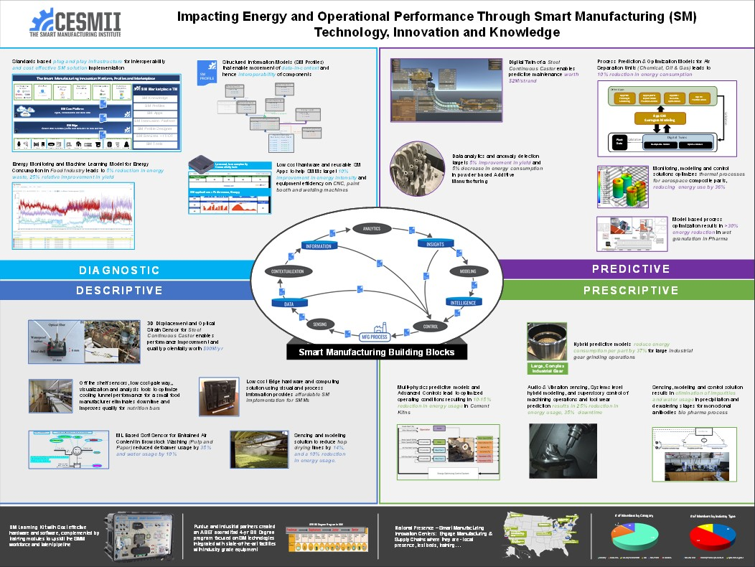
Steel
SMMs
Chemicals
Thermal
Food
Steel
Grinding
Cement
Paper
Aerospace
Drying

Slide 13
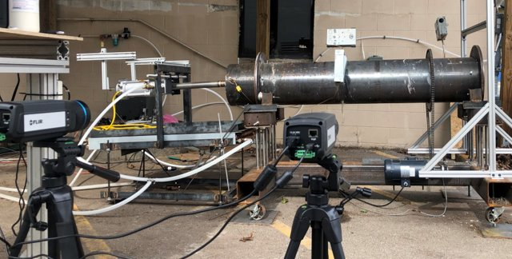
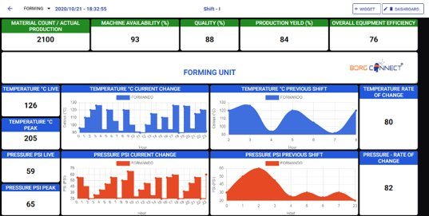
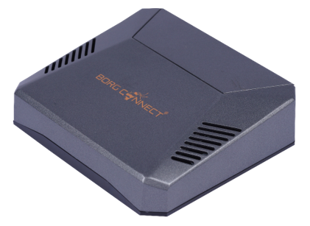
Project Examples
SM applications – Performance, Energy
Low-cost, low-complexity
Connectivity hub
Multi-physics predictive models and Advanced Controls lead to optimized operating conditions resulting in 10-15% reduction in energy usage in Cement Kilns
Low cost hardware and reusable SM Apps to help SMMs target 10% improvement in energy intensity and equipment efficiency on CNC, paint booth and welding machines

Slide 14

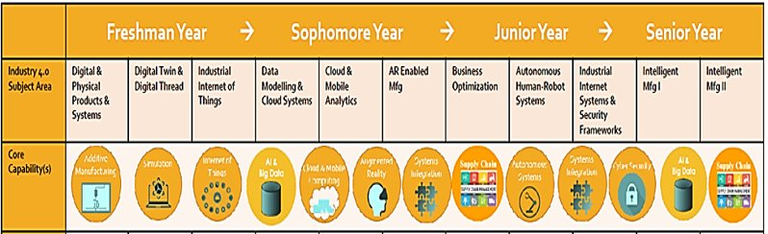
Project Examples
4 YR BS Degree Program in SM
Purdue and industrial partners created an ABET accredited 4-yr BS Degree program focused on SM technologies integrated with state-of-the-art facilities with industry grade equipment
ML Based Soft Sensor for Entrained Air Content in Browstock Washing (Pulp and Paper) reduced defoamer usage by 35% and water usage by 10%

Slide 15
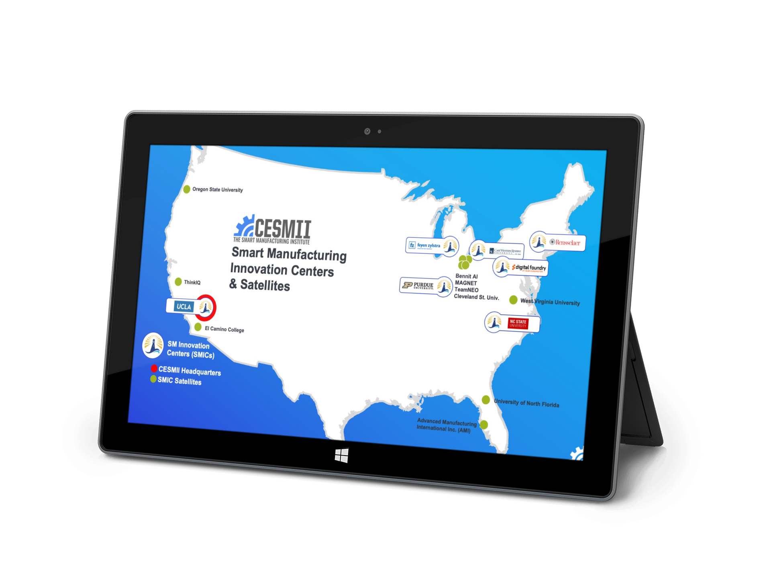







National Reach through SM Innovation Centers
Enable SM access for small, medium, and large businesses, connecting manufacturing assets to our SM Innovation platform, national policy development, industry awareness, and workforce development.

Slide 16
























A National ‘Think Tank’ of Smart Manufacturing Leaders,
Advocating for the Transformation of the Ecosystem
Our Charter: The Smart Manufacturing Executive Council has been formed to engage business and technology executives, thought leaders and visionaries advocating for the transformation of the U.S. manufacturing ecosystem.
Our Objective: To develop practical guidance and policy recommendations
that will help this ecosystem across
this digital divide.
Leverage admired Manufacturing Businesses, demonstrating their leadership on this journey, and showing others the way
Inspire this ecosystem to evolve their strategies and business models to truly support the democratization of manufacturing technologies and ensure that SMMs can engage in Smart Manufacturing as well
Provide guidance for each of the 8 stakeholder groups in our manufacturing ecosystem, helping them understand their role in this evolution, and invest in the knowledge and skills required for this transformation
Inform US policy makers on the transformative actions and policies that will accelerate US
adoption of Smart Manufacturing
LEARN MORE

Slide 17
Backup Slides

